Slide 1
Blazor Taking .NET to the SPA!
Alan P. Barber
2020.01.22

Slide 2
Alan P. Barber
Senior Consultant at Improving
Software Developer
Computer Scientist
Scrum Master
Crohn's Disease Fighter
.NET Foundation Member
Husband & Father
Blog: alanbarber.com
Twitter: @alanbarber
GitHub: github.com/alanbarber

Slide 3
Disclaimer
I’m no expert.
I’m still learning.
Some of the code is still in preview and subject to change.

Slide 4
Blazor is a SPA framework using WebAssembly to build client-side web UIs
Create
Create rich interactive UIs using C# instead of JavaScript.
Share
Share server-side and client-side app logic written in .NET.
Render
Render the UI as HTML and CSS for wide browser support, including mobile browsers.

Slide 5
Let’s take a step back
Before we can talk about Blazor, we need to cover a few other items!

Slide 6
What is a SPA (Single-page application)?
“A single-page application is a web application or web site that interacts with the user by dynamically rewriting the current page rather than loading entire new pages from a server.
This approach avoids interruption of the user experience between successive pages, making the application behave more like a desktop application.” [1]
React, Angular, Vue are all examples of SPA frameworks written in JavaScript
[1] https://en.wikipedia.org/wiki/Single-page_application

Slide 7
What is WebAssembly?
“WebAssembly (abbreviated Wasm) is a binary instruction format for a stack-based virtual machine. Wasm is designed as a portable target for compilation of high-level languages like C/C++/Rust, enabling deployment on the web for client and server applications.” [1]
Chrome, Edge, Firefox, and WebKit all support WebAssembly 1.0
Check out Guy Royse’s – An Introduction to WebAssembly [2] to learn more
[1] https://webassembly.org
[2] https://www.youtube.com/watch?v=C4fxz0004Nc

Slide 8
OK, Back to Blazor

Slide 9
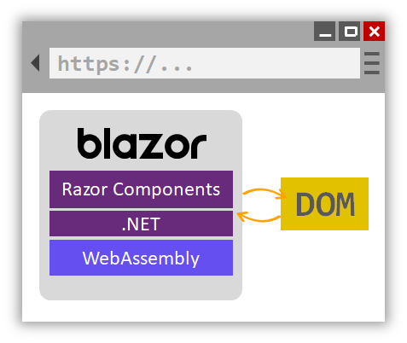
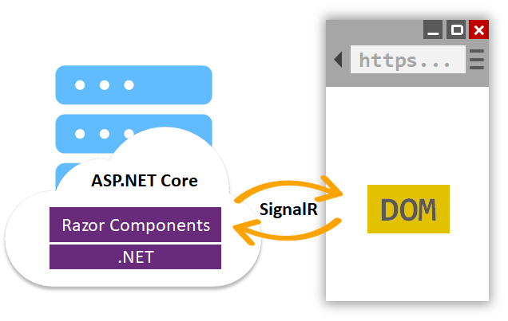
Hosting Models Blazor in two forms
WebAssembly
Server
Still in preview
Production ready

Slide 10
This just in! A potential 3rd hosting model!
Announcing Experimental Mobile Blazor Bindings (January 14th, 2020)
These bindings enable developers to build native mobile apps using C# and .NET for iOS and Android using familiar web programming patterns. This means you can use the Blazor programming model and Razor syntax to define UI components and behaviors of an application. The UI components that are included are based on Xamarin.Forms native UI controls, which results in beautiful native mobile apps.
For more information visit:
https://devblogs.microsoft.com/aspnet/mobile-blazor-bindings-experiment/

Slide 11
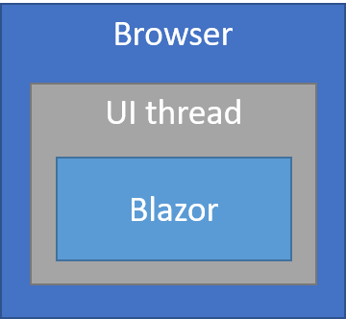
WebAssembly
The principal hosting model for Blazor is running client-side in the browser on WebAssembly. The Blazor app, its dependencies, and the .NET runtime are downloaded to the browser.
The app is executed directly on the browser UI thread. UI updates and event handling occur within the same process.
The app's assets are deployed as static files to a web server or service capable of serving static content to clients.

Slide 12
WebAssembly
Pros
Cons
There's no .NET server-side dependency. The app is fully functioning after downloaded to the client.
Client resources and capabilities are fully leveraged.
Work is offloaded from the server to the client.
An ASP.NET Core web server isn't required to host the app. Serverless deployment scenarios are possible (for example, serving the app from a CDN).
The app is restricted to the capabilities of the browser.
Capable client hardware and software (for example, WebAssembly support) is required.
Download size is larger, and apps take longer to load.
.NET runtime and tooling support is less mature. For example, limitations exist in .NET Standard support and debugging.

Slide 13
WebAssembly – Supported Browsers
Microsoft Edge | Current
Mozilla Firefox | Current
Google Chrome, including Android | Current
Safari, including iOS | Current
Microsoft Internet Explorer | Not Supported

Slide 14
WebAssembly
C# code files and Razor files are compiled into .NET assemblies.
The assemblies and the .NET runtime are downloaded to the browser.
Blazor WebAssembly bootstraps the .NET runtime and loads the assemblies for the app.
Blazor WebAssembly runtime uses JavaScript interop to handle DOM manipulation and browser API calls.

Slide 15
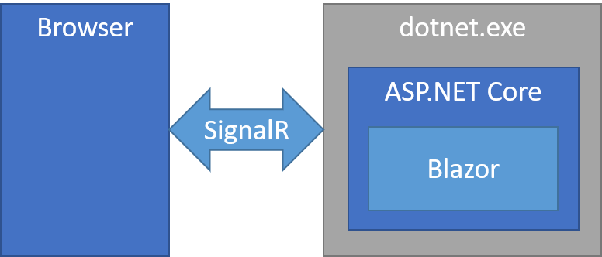
Server
Blazor decouples component rendering logic from how UI updates are applied. Blazor Server provides support for hosting Razor components on the server in an ASP.NET Core app. UI updates are handled over a SignalR connection.
The runtime handles sending UI events from the browser to the server and applies UI updates sent by the server back to the browser after running the components.
The connection used by Blazor Server to communicate with the browser is also used to handle JavaScript interop calls.

Slide 16
Server
Pros
Cons
Download size is significantly smaller than a Blazor WebAssembly app, and the app loads much faster.
The app takes full advantage of server capabilities, including use of any .NET Core compatible APIs.
.NET Core on the server is used to run the app, so existing .NET tooling, such as debugging, works as expected.
Thin clients are supported. For example, Blazor Server apps work with browsers that don't support WebAssembly and on resource-constrained devices.
The app's .NET/C# code base, including the app's component code, isn't served to clients.
Higher latency usually exists. Every user interaction involves a network hop.
There's no offline support. If the client connection fails, the app stops working.
Scalability is challenging for apps with many users. The server must manage multiple client connections and handle client state.
An ASP.NET Core server is required to serve the app. Serverless deployment scenarios aren't possible (for example, serving the app from a CDN).

Slide 17
Server – Supported Browsers
Microsoft Edge | Current
Mozilla Firefox | Current
Google Chrome, including Android | Current
Safari, including iOS | Current
Microsoft Internet Explorer | 11*
* Additional polyfills are required

Slide 18
WebAssembly or Server
Which should I use?

Slide 19
WARNING Personal Opinion
The server hosting model is not a SPA as it requires constant contact to the server to perform all work.
Microsoft made a mistake in building the server option and more importantly, in releasing it first, is going to confuse developers and potentially sour the community's opinion of Blazor.
I encourage all developers to not use the server hosting model and wait until the final release for the WebAssembly version before starting to build Blazor based applications.
Current ETA for WebAssembly release is early 2020.

Slide 20
Create your first app

Slide 21
Prerequisites
.NET Core 3.1 SDK
Blazor WebAssembly template
From command line run the following
dotnet new -i Microsoft.AspNetCore.Blazor.Templates::3.1.0-preview4.19579.2
Visual Studio 2019 (v16.3.0+)
https://docs.microsoft.com/en-us/visualstudio/releases/2019/release-notes-v16.3#16.3.0
https://dotnet.microsoft.com/download/dotnet-core/3.1

Slide 22
Visual Studio 2019 (v16.3.0+)
Create a new project.
Select Blazor App. Select Next.
Provide a project name in the Project name field or accept the default project name. Confirm the Location entry is correct or provide a location for the project. Select Create.
For a Blazor WebAssembly experience, choose the Blazor WebAssembly App template.
Press F5 to build and run the app.

Slide 23
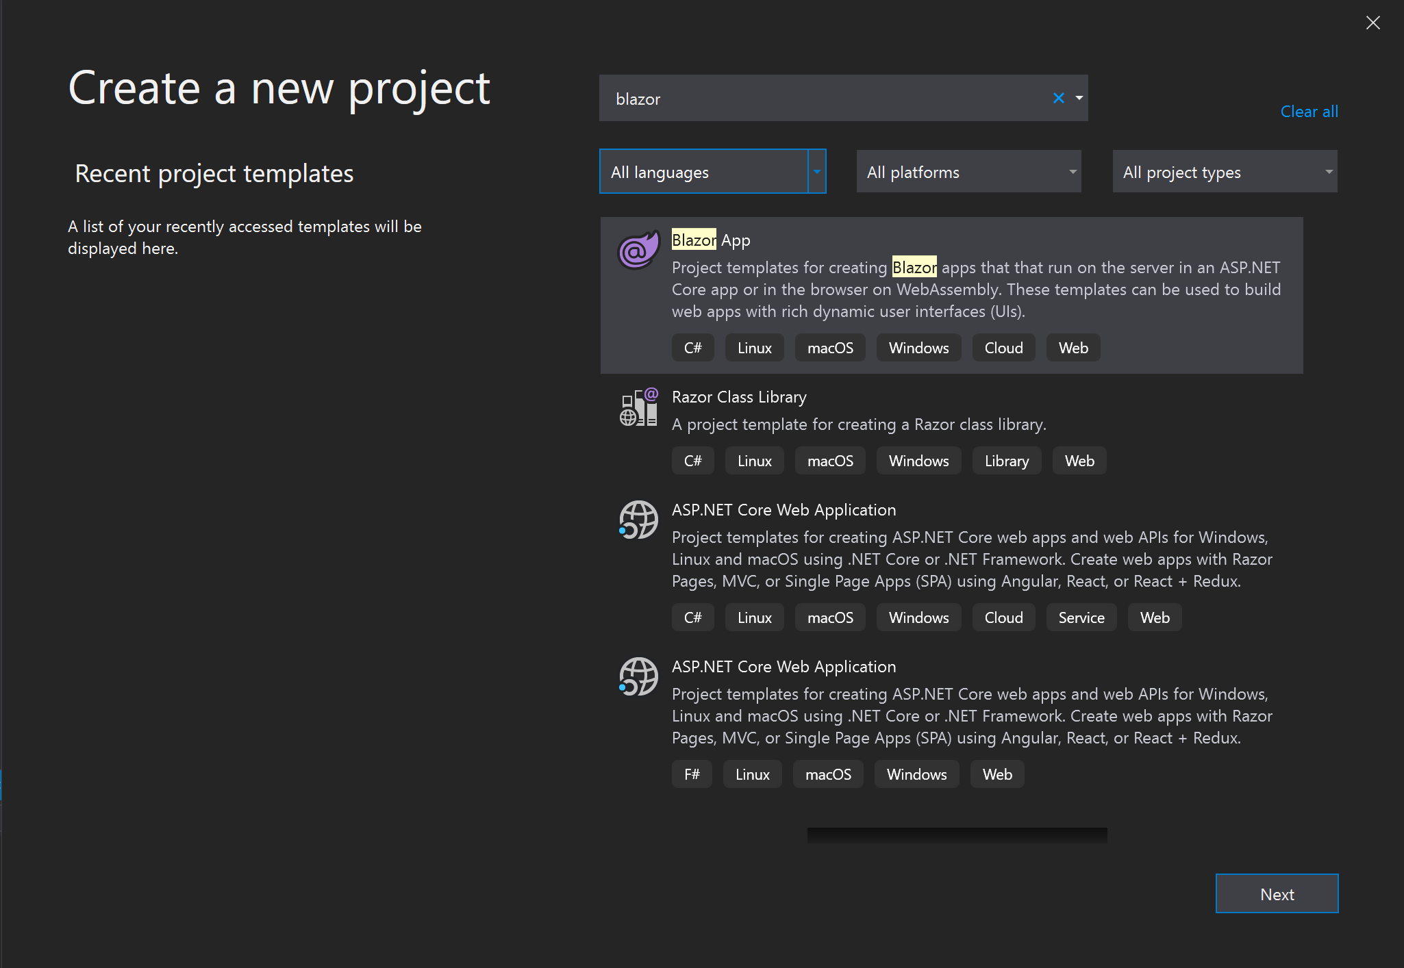

Slide 24
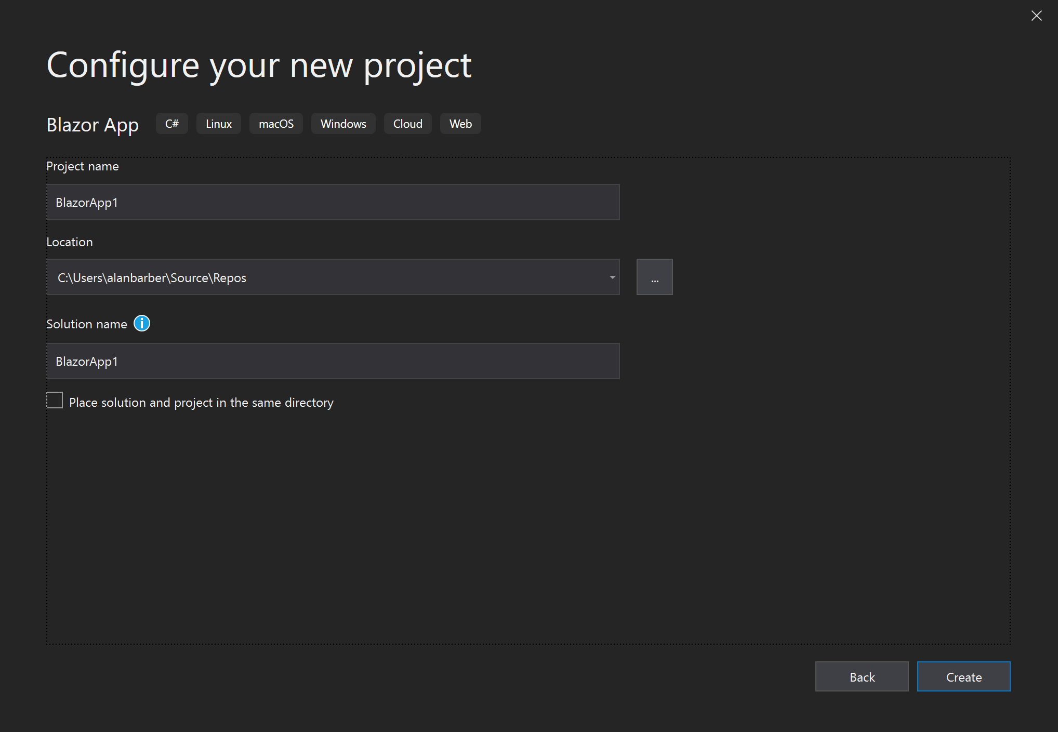

Slide 25
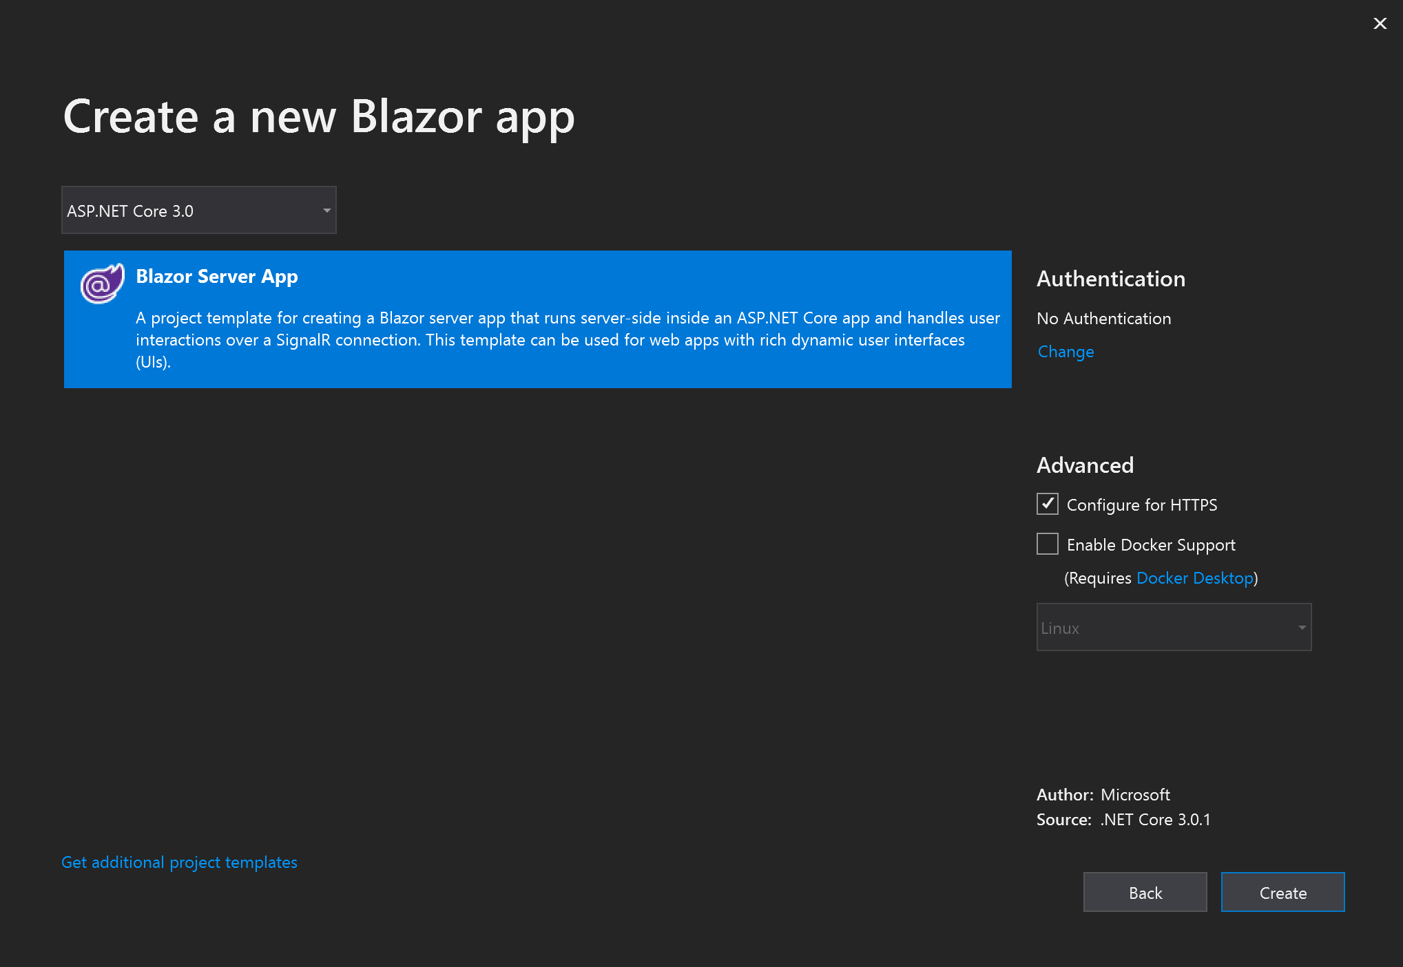

Slide 26
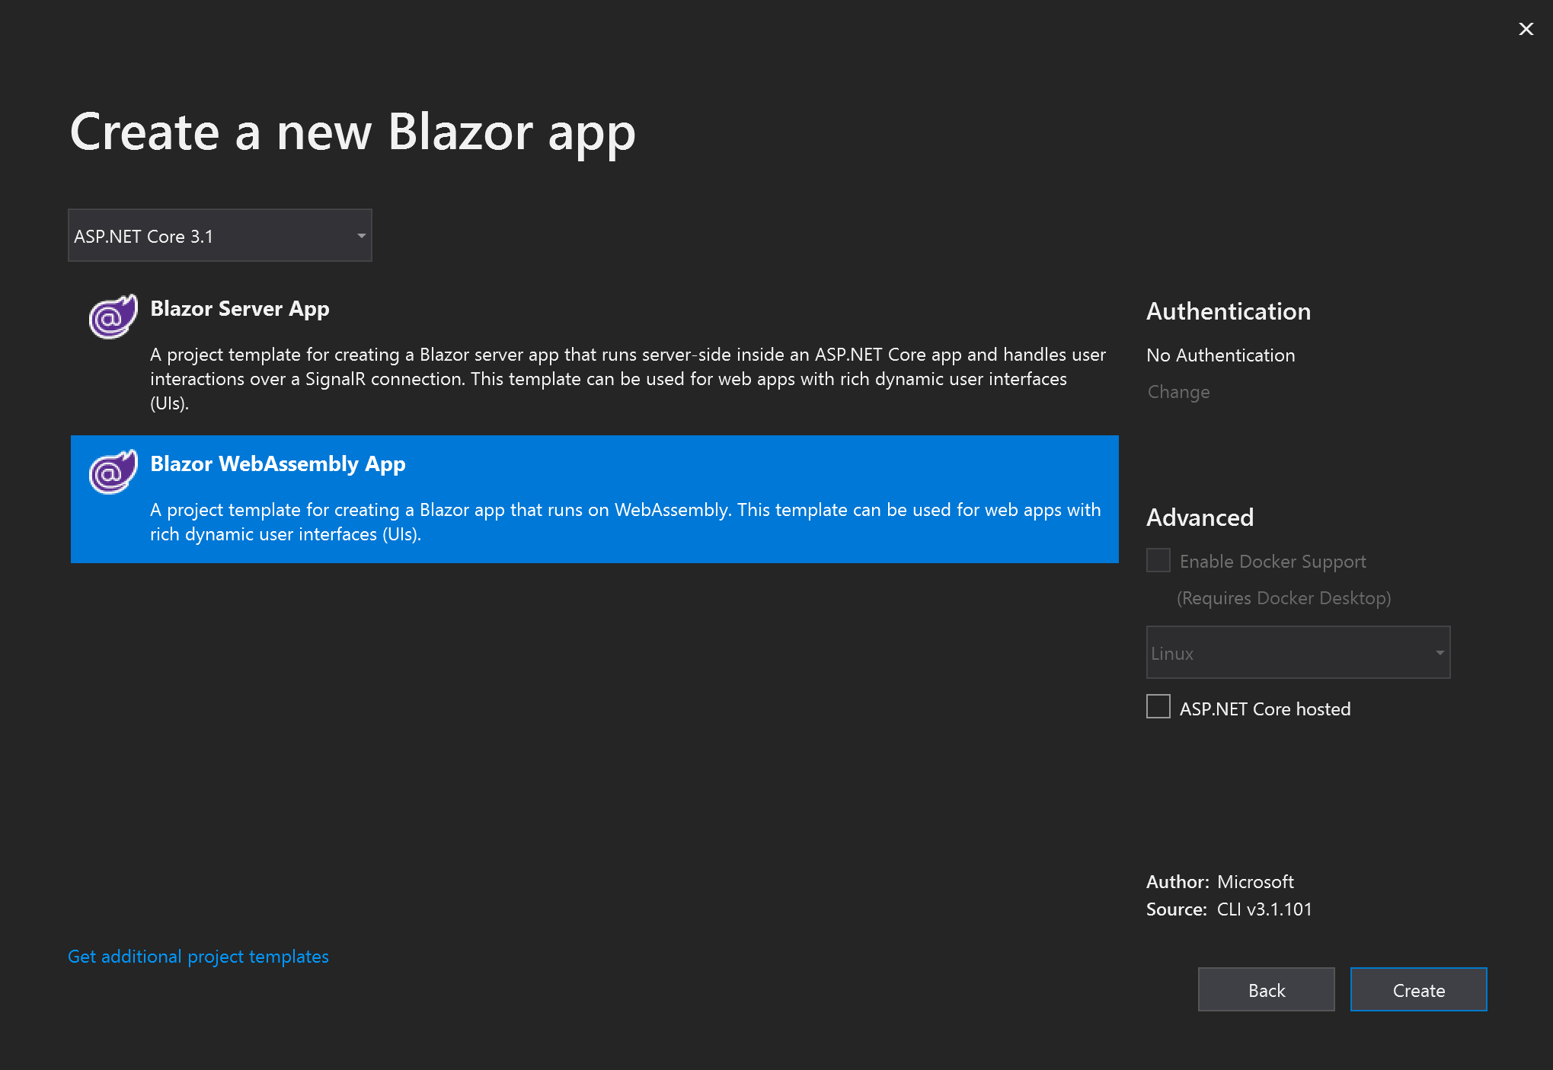

Slide 27
Visual Studio Code or Other IDE
Run the following from a command line
dotnet new blazorwasm -o WebApplication1
cd WebApplication1
dotnet run
Open your browser to https://localhost:5001

Slide 28
Components

Slide 29
Components
Components are implemented in Razor component files (.razor) using a combination of C# and HTML markup. A component in Blazor is formally referred to as a Razor component.
A component's name must start with an uppercase character. For example, MyCoolComponent.razor is valid, and myCoolComponent.razor is invalid.
The UI for a component is defined using HTML. Dynamic rendering logic (for example, loops, conditionals, expressions) is added using an embedded C# syntax called Razor. When an app is compiled, the HTML markup and C# rendering logic are converted into a component class. The name of the generated class matches the name of the file.
Members of the component class are defined in an @code block. In the @code block, component state (properties, fields) is specified with methods for event handling or for defining other component logic.
More than one @code block is permissible.

Slide 30
Components
<h1 style="font-style:@_headingFontStyle">@_headingText</h1>
@code {
private string _headingFontStyle = "italic";
private string _headingText = "Put on your new Blazor!";
}

Slide 31
Components – With Parameter(s)
<h1>@Title</h1>
@code {
[Parameter]
public string Title { get; set; }
}

Slide 32
Layouts

Slide 33
Layouts
A layout is just a special type of component. Layouts are defined in Razor templates.
To make a component into a layout:
Inhert from LayoutComponentBase
Place a @Body property in the layout markup
Layouts can be nested.

Slide 34
Layouts
@inherits LayoutComponentBase
<header>My New Layout</header>
<nav/>
@Body
<footer>Copyright @TMYear</footer>
@code {
public string TMYear { get; set; } = DateTime.Now.Year;
}

Slide 35
Pages

Slide 36
Pages
A page just like a layout is just a special type of component.
To make a component into a page:
Place a @Page property at the top of the component

Slide 37
Pages
@page "/"
<h1>Hello, world!</h1>
Welcome to your new app.
<MyComponent Title="How is Blazor working for you?"/>

Slide 38
Pages – With Parameters
@page "/user/{Id:int}"
<h1>Hello, User #@Id!</h1>
@code
{
[Parameter]
public int Id { get; set; }
}

Slide 39
Routing

Slide 40
Routing
In the App.razor file you will find your Router component that defines how pages are loaded and accessed.

Slide 41
Routing
<Router AppAssembly="@typeof(Program).Assembly">
<Found Context="routeData">
<RouteView RouteData="@routeData" DefaultLayout="@typeof(MainLayout)" />
</Found>
<NotFound>
<LayoutView Layout="@typeof(MainLayout)">
<p>Sorry, there's nothing at this address.</p>
</LayoutView>
</NotFound>
</Router>

Slide 42
Forms and validation

Slide 43
Forms and validation
Forms and validation are supported in Blazor using data annotations.

Slide 44
Forms and validation – model
using System.ComponentModel.DataAnnotations;
public class ExampleModel {
[Required]
[StringLength(10, ErrorMessage = "Name is too long.")]
public string Name { get; set; }
}

Slide 45
Forms and validation – form component
<EditForm Model="@exampleModel“ OnValidSubmit="@HandleValidSubmit">
<DataAnnotationsValidator />
<ValidationSummary />
<InputText id="name" @bind-Value="@exampleModel.Name" />
<button type="submit">Submit</button>
</EditForm>
@code {
private ExampleModel exampleModel = new ExampleModel();
private void HandleValidSubmit() {
Console.WriteLine("OnValidSubmit");
}
}

Slide 46
Forms and validation build-in input components
Input component | Rendered as HTML
InputText | <input>
InputTextArea | <textarea>
InputSelect | <select>
InputNumber | <input type="number">
InputCheckbox | <input type="checkbox">
InputDate | <input type="date">

Slide 47
Demo – Blazor Workshop
Let’s walk through some code!

Slide 48
Questions or Comments

Slide 49
Thank you!
Blog: alanbarber.com
Twitter: @alanbarber
GitHub: github.com/alanbarber
Resources
https://dotnet.microsoft.com/apps/aspnet/web-apps/blazor
https://github.com/AdrienTorris/awesome-blazor
https://github.com/dotnet-presentations/blazor-workshop
https://blazorfiddle.com/
https://github.com/aspnet/samples/tree/master/samples/aspnetcore/blazor

