Slide 1
Passwords Don’t Work
Using Two Factor Authentication
To Secure Users
Alan P. Barber
Notes:
Hello everyone! My name is Alan P. Barber. I’m a software developer from Columbus, Ohio. I’ve been programming professionally for a decade now. I currently work for a company called Improving Enterprises where I work as a consultant. I’m also the President of the Central Ohio .Net Developers Group. So, I’m here today to talk to you about two factor authentication.

Slide 2
Let Me Tell You A Story
Notes:
Let me tell you a little story about Bob…

Slide 3
The Moral Of The Story
PASSWORDS
DON’T WORK
Notes:
OK, maybe that’s a misnomer…I just wanted to use the title in a slide.

Slide 4
The REAL Moral Of The Story
Passwords aren’t good for proving identity
Notes:
What’s the real moral of the story? Passwords aren’t secure and you cannot rely on them to prove the identity of a user.

Slide 5
Why can’t you trust passwords?
Website hacks
Viruses, Trojans, Keyloggers, Etc
Man In The Middle attacks
Phishing attacks
Notes:
The bottom line is that, there is a good chance that a user’s password is going to end up being exposed at some point.

Slide 6
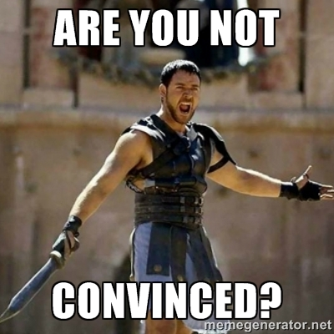
Have I convinced you yet?
Notes:
Hopefully, I’ve convinced you not to trust passwords and that you need something more

Slide 7
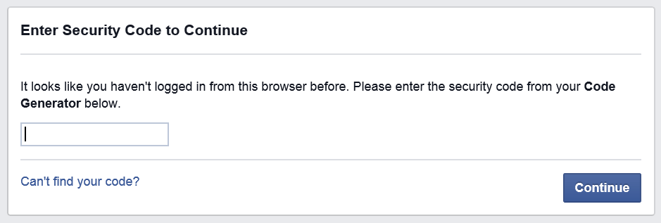
The Solution
Once a user provides their username and password,
ask them to prove their identity.
Notes:
That’s simple enough but how do we do that?

Slide 8
Lets Talk About Multi Factor Authentication
Multi Factor Authentication is a method of user access control using several separate verification factors.
There are 3 classifications of factors
Knowledge
Something the user knows
Possession
Something the user has
Inherence
Something the user contains
Notes:
Before we get into 2FA lets first take a quick step back and talk about multi factor authentication in general. What is MFA?

Slide 9
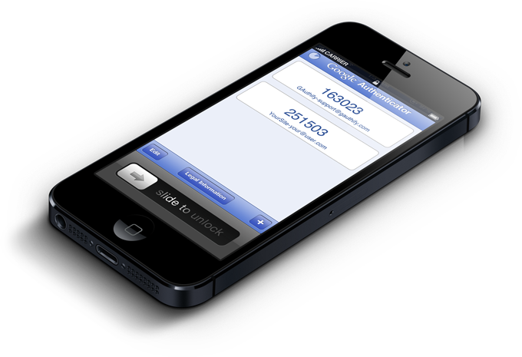
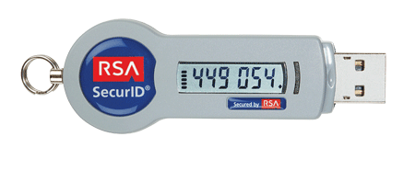
What is Two Factor Authentication
Two Factor Authentication is a way of providing identification of a user by means of two different components.
A secret the user knows (password)
A physical object the user has (token, phone, etc)
Notes:
A username and password just aren’t good enough to prove the identity of person logging onto a system. Two Factor Authentication adds the requirement of having a physical object that the user possesses to aid in the proof of their identity.
We will be focusing on mobile phone software based authentication but there are also hardware devices out there designed by companies like RSA.

Slide 10
Why Two Factor Authentication
A random hacker may know all your secrets but can’t gain access to an item you possess.
Notes:
Two Factor Authentication helps mitigate the damage that can be done by finding out a persons username and password.

Slide 11
Methods of Implementation
Let’s take a look at the common methods that a user will prove their identity.
Notes:
Let’s look at common methods to prove identity.

Slide 12
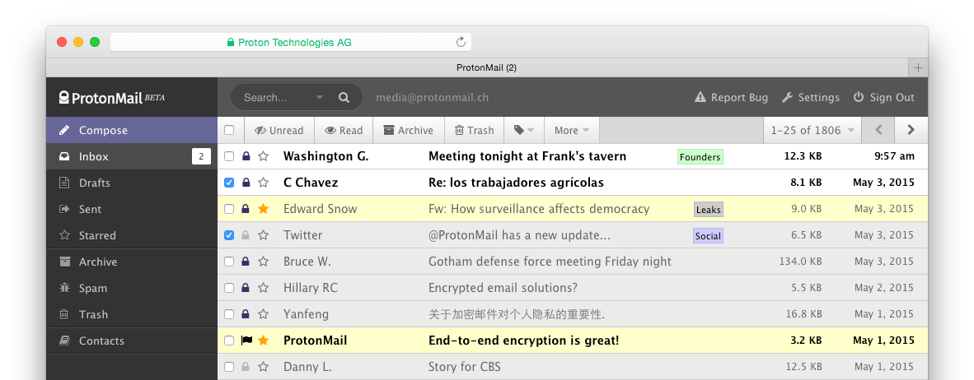
Methods of Implementation Email
Pros
Easy for developers to implement
Easy for end users
Cons
Email can be unreliable
Not very secure
Notes:
Email is probably the easiest way to implement 2FA. You probably already know the users email so there’s no real setup. You just email them a login code. Problems arise with slow mail service making users wait, spam filters blocking the message, etc. Also, it’s not very secure, there have been reports of dedicated hackers hacking peoples email services to get the login codes.

Slide 13
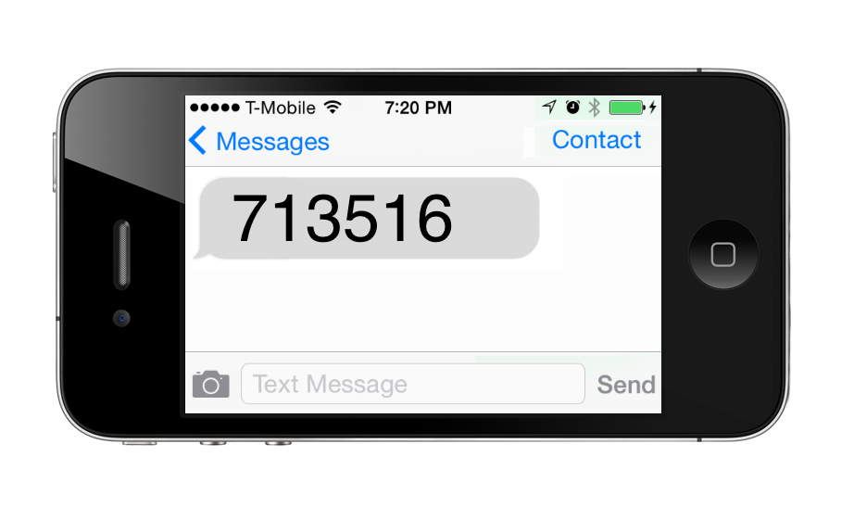
Methods of Implementation SMS / Text Messages
Pros
Secure
Easy for end users
Cons
SMS can be unreliable
Costs money
Notes:
SMS is a very common method for implemented 2FA. It’s fairly secure since it’s going to be hard for a hacker to gain access to your phone to capture a SMS message. Similar to email you do run into issues with slow SMS services. Worse still it’s broken if you have no cell signal, such as when out of the country. There is also a cost for your service to send SMS via a gateway service and end users may have to pay a fee for receiving SMS messages.

Slide 14
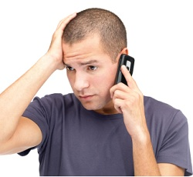
Methods of Implementation Telephony / Phone Callbacks
Pros
Secure
Good fallback for users without SMS (ex: office phones)
Cons
Costs money
People don’t like phone calls
Notes:
There are two styles of phone callback utilized. First is audio recording of the passcode for you to enter on the screen. The second is a simpler method that asks you to press a key to authorize.

Slide 15
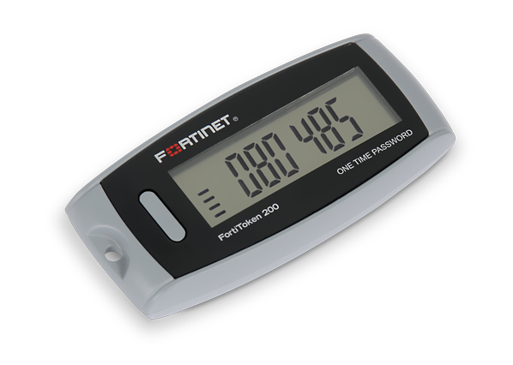
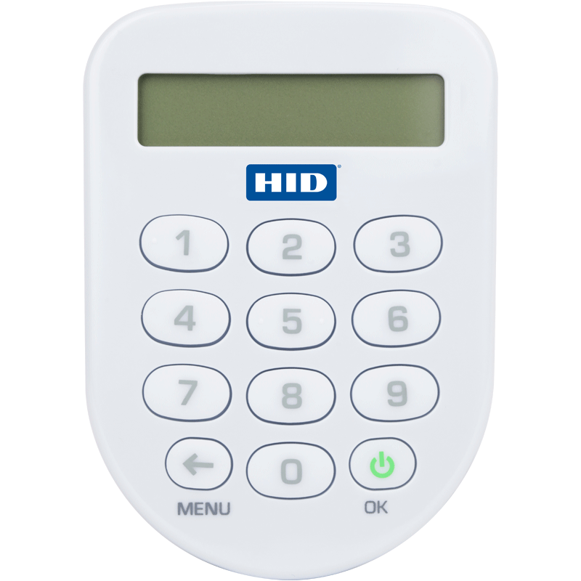
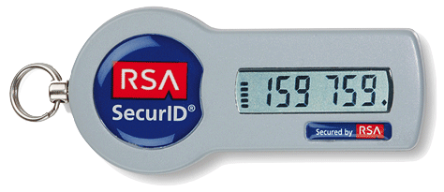
Methods of Implementation Tokens / Security Fob
Pros
Secure
Easy for end users
Cons
Complex Implementation
Cost
Notes:
There are time based, counter based (click a button) or challenge response (enter an input on device, it gives you a password to type in). Requires running a management server to track devices and authenticate devices.

Slide 16
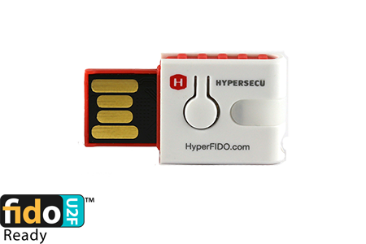
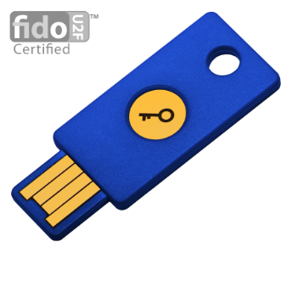
Methods of Implementation Universal 2nd Factor
Pros
Secure
Easy for end users
Cons
Limit support for the web
Cost
Notes:
U2F was created by FIDO Alliance (Fast Identity Online). Currently only supported on Chrome but Firefox and IE edge are coming. Contains a small system on a chip with a unique code that performs computations using public/private keypair to identify you.

Slide 17
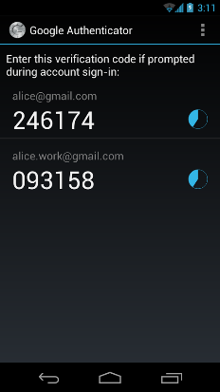
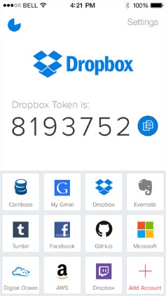
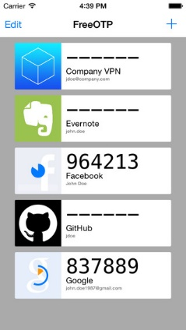
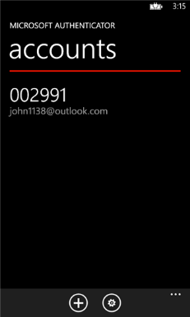
Methods of Implementation Mobile Authenticator App
Pros
Free*
No need to carry another device
Cons
Can be confusing for end users
Requires sharing a secret key
Notes:
A software solution, often called soft tokens) that uses a open standard to compute One Time Passwords.

Slide 18
3rd Party Web Services
Authy (authy.com)
Mobile, Desktop, Voice, SMS
Duo Security (duosecurity.com)
Mobile, Voice, SMS, Tokens, U2F
Trustwave (trustwave.com)
Mobile app, Voice, SMS
Notes:
There are several pay services out there to help you implement without having to do the hard work yourself.

Slide 19
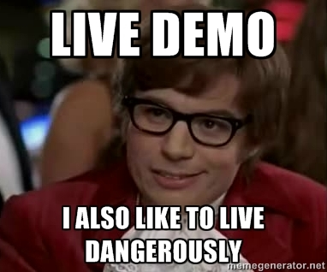
Demo Time
Enough with the slides, lets look at some code!
Notes:
Lets look at a quick demo to see how easy it is to add 2FA to an ASP.Net MVC webapp

Slide 20
One Time Passwords
A subset of Two Factor Authentication that uses the generation of unique, single use login codes

Slide 21
One Time Passwords
There are two types of One Time Passwords in use
HOTP – HMAC One Time Password
HOTP generates a one time password via an incrementing counter
TOTP – Time-based One Time Password
TOTP generates a one time password via the current time interval
Notes:
These are generated password that are used once and automatically changed for each use. Both are open standards. HMAC stands for hash message authentication code

Slide 22
HOTP – HMAC One Time Password
Definition
Let:
K be a secret key
C be a counter
D be a number of desired digits
HMAC(K,C) be an HMAC calculated with a SHA-1 hash algorithm
Truncate() be a function that selects 4 bytes
Then:
HOTP(K,C,D) = (Truncate(HMAC(K,C)) & 0x7FFFFFFF) mod 10^{D}
IETF RFC 4226 (Published in Dec 2005)
Notes:
See RFC 4226 for detailed specs: https://www.ietf.org/rfc/rfc4226.txt

Slide 23
TOTP – Time-based One Time Password
Definition
Let:
K be a secret key
TN be the current time, T0 be Epoch time
TS be a time step, expressed in seconds
D be a number of desired digits
unixtime() be a function to convert a date into POSIX.1 time
HOTP(K,C,D) be a HMAC One Time Password algorithm
Then:
TOTP(K,TN,TS,D) = HOTP(K, ((unixtime(TN) – unixtime(T0)) / TS), D)
IETF RFC 6238 (Published in May 2011)
Notes:
See RFC 6238 for detailed specs: https://www.ietf.org/rfc/rfc6238.txt

Slide 24
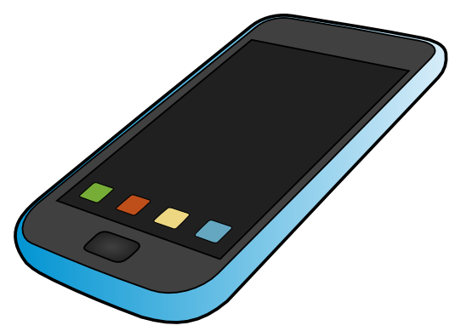
Phone Apps
Android
Google Authenticator, Authy, FreeOTP
IPhone
Google Authenticator, Authy, FreeOTP
Windows Phone
Microsoft Authenticator
Notes:
There are many different OTP based apps for all the major mobile phone platforms. Some are free, some cost money. Some are very simple like Google’s and Microsoft’s authenticator apps while others like Authy add extra features and include cloud backups and sync across devices.

Slide 25
Another Demo
Notes:
Now lets see how one time passwords work…

Slide 26
A Few Lasts Notes
Implement multiple methods for fallback
Educate your users on why 2FA is important

Slide 27
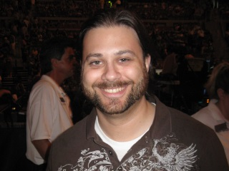
Thank You!
Alan P. Barber
Website: alanbarber.com
Email: alan@alanbarber.com
Twitter: @alanbarber
Notes:
Thank you for your time, hopefully you learned something new. I have a blog that I occasionally post stuff too and if you have any questions you can contact me via email or twitter.

Slide 28
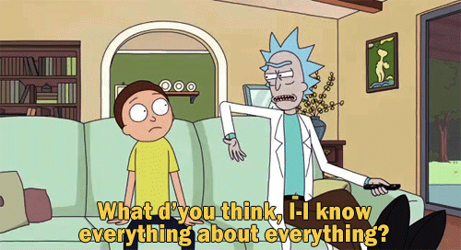
Questions, comments, complaints?
Ask me questions! I’ll try to answer them!
http://rickandmortythings.tumblr.com/
Notes:
Do you have any questions?

