Slide 1
Polly The .NET resilience framework
Alan P. Barber
2019.07.25

Slide 2
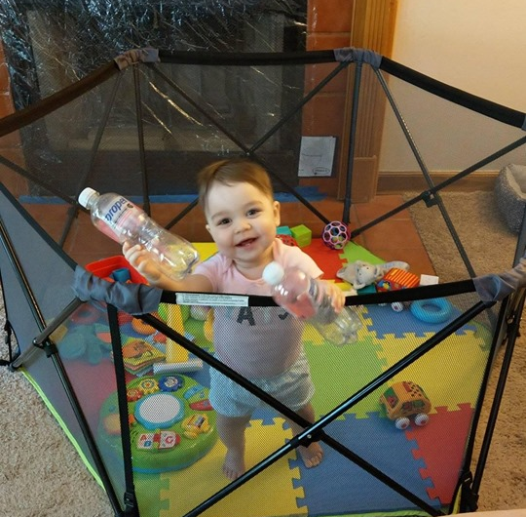
Alan P. Barber
Senior Consultant at Improving
Software Developer
Computer Scientist
Scrum Master
Crohn's Disease Fighter
Father
Husband
Blog: alanbarber.com
Twitter: @alanbarber
GitHub: github.com/alanbarber

Slide 4
What is a Resilience Framework?
A tool to help applications recover from transient failures and extended outages in external infrastructure for which they depends upon.
If recovery is not possible, the framework should help applications to fail gracefully.

Slide 5
The building blocks

Slide 6
Policy
Fluent API
Reusable
Thread safe
Execution delegate
Sync and Async
Wrap multiple together

Slide 7
Registry
Policy Store
Dictionary pattern
Reusable
Dependency Injection

Slide 8
A tale of two strategies

Slide 9
Reactive Strategies
Retry
“Maybe it's just a blip”
Wait and Retry
“Let’s give it a second to recover”
Circuit Breaker
“Give the system a break”
Fallback
“Give up and fail gracefully”

Slide 10
Proactive Strategies
Timeout
“I’m not going to wait forever”
Caching
“You already asked me that”
Bulkhead Isolation
“Controlled access to a resource”

Slide 11
Code samples

Slide 12
Retry

Slide 13
Fallback

Slide 14
Wrapping policies together

Slide 15
Policy Registry

Slide 16
Unit testing

Slide 17
NoOp
Provides a policy which executes passed delegates without intervention.

Slide 18
An important note

Slide 19
Support target platforms by version
Target platform | Earliest Polly version with support | Latest Polly version with support
.NET Standard 2.1 for use with IHttpClientFactory | 6.0.1 | Current
.NET Standard 2.0 | 6.0.1 | Current
.NET Standard 2.0 | 5.0.3 | Current
.NET Standard 1.1 | 5.0.3 | Current
.NET Standard 1.0 | 5.0.3 | 5.1.0
.NET Framework 4.5 | 1.0.0 | 5.9.0

Slide 20
Resources
http://www.thepollyproject.org
https://github.com/App-vNext/Polly

