Slide 1
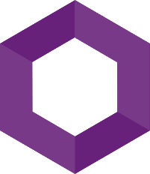
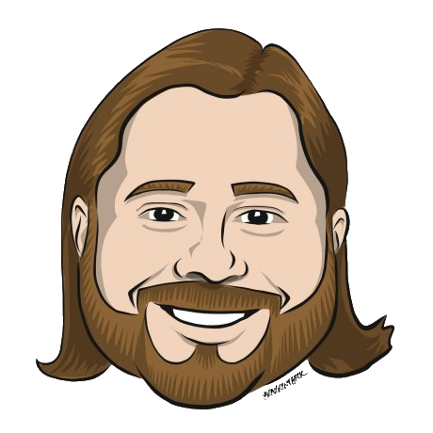
Microsoft Orleans
Building Highly Scalable Systems With Virtual Actors
Alan P. Barber
Principal Consultant, Improving
Blog: alanbarber.com
Twitter: @alanbarber
GitHub: github.com/alanbarber
2022.07.28

Slide 2
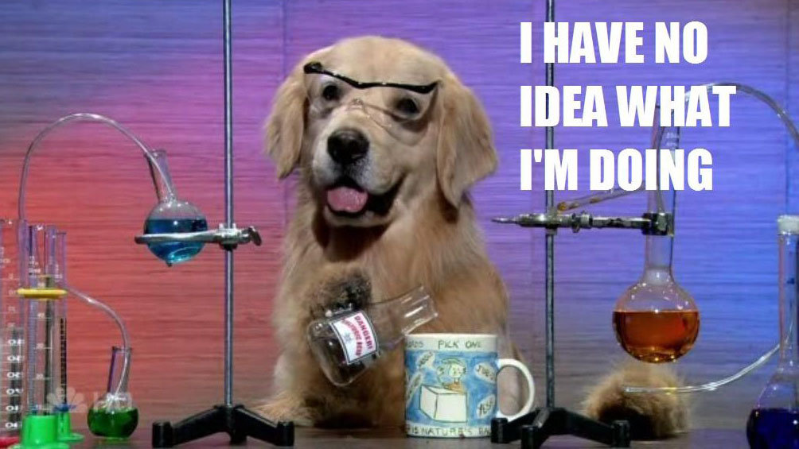
Disclaimer
I’m no expert.
I’m still learning.
I make no guarantees.

Slide 3
What is Orleans
The 50,000 foot view

Slide 4
What is Orleans
It’s both a runtime and a programming model
It’s a framework for robust, scalable distributed applications
Implements the concept of Virtual Actors
Notes:
One of the primary design objectives of Orleans is to simplify the complexities of distributed application development by providing a common set of patterns and APIs.
Developers familiar with single-server application development can easily transition to building scalable distributed cloud services using Orleans.
Orleans scales from a single on-premises server to globally distributed, highly available applications in the cloud

Slide 5
The Virtual Actor Model
What makes Orleans special

Slide 6
The Virtual Actor Model – What is an actor?
The actor model in computer science is a mathematical model that treats actor as the universal primitive of concurrent computation. In response to a message it receives, an actor can: make local decisions, create more actors, send more messages, and determine how to respond to the next message received. Actors may modify their own private state, but can only affect each other indirectly through messaging (removing the need for lock-based synchronization). [1]
[1] https://en.wikipedia.org/wiki/Actor_model

Slide 7
The Virtual Actor Model
As the name implies, should be purely logical business entities
You cannot explicitly create nor destroy them
Since an actor always exists, they are always addressable
Known as Grains in Orleans
Notes:
The actor model is a programming model in which each actor is a lightweight, immutable object, aka a class, that encapsulates a piece of state and corresponding behavior. Actors communicate exclusively with each other using asynchronous messages.
Actors are purely logical entities that always exist, virtually. An actor cannot be explicitly created nor destroyed, and its virtual existence is unaffected by the failure of a server that executes it. Since actors always exist, they are always addressable.

Slide 8
Grains
The building blocks

Slide 9
Grains
Grains are the implementation of a virtual actor
Defined by an interface
Has a unique identity
Includes code to send and receive messages
Has an internal memory state that can be persisted
Hosted in Silos

Slide 10
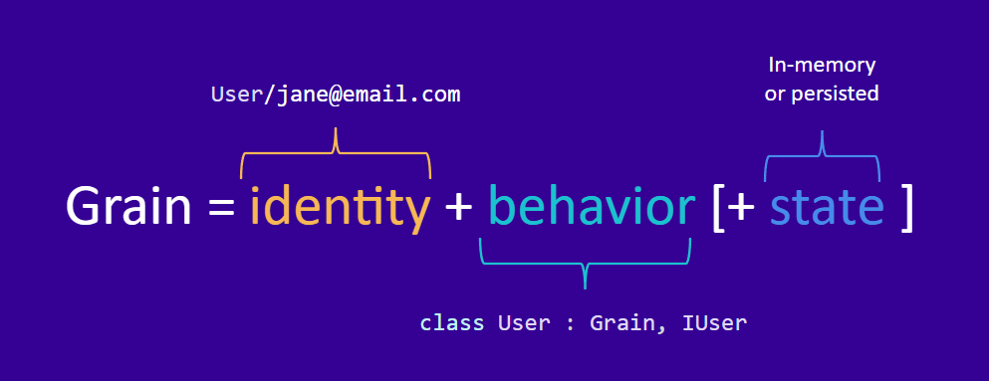
Grains – A visual representation

Slide 11
Grains - Identity
Guid
Integer
String

Slide 12
Grains - Lifecyle
Active in memory
Deactivating
Persisted
Activating

Slide 13
Silos
Where else would you put grain?

Slide 14
Silos
A silo is a host for grains
Responsible for the activation & deactivation of grains
Can be clustered for scalability & fault -tolerance

Slide 15
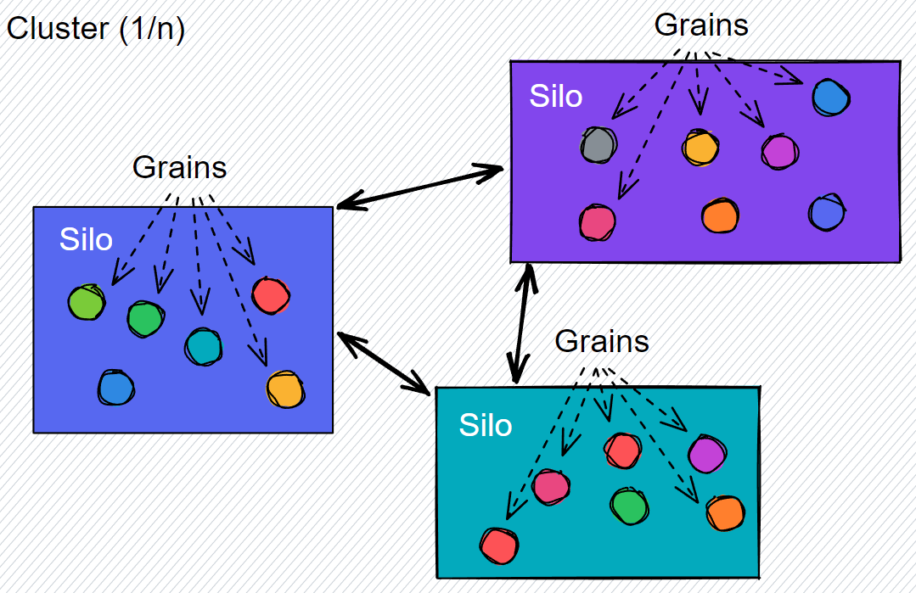
Silos
Silos can host multiple grains
In a cluster, silos coordinate to distribute grains
Grains can communication across silos in the same cluster

Slide 16
Orleans in The Real World
You’ve probably interacted with Orleans and didn’t even know it

Slide 17
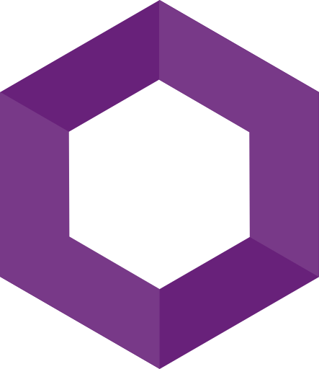
Azure
PlayFab
Skype
Azure
IoT
Xbox Game
Studios
Orleans
Azure AD
Azure
Quantum
Dynamics 365
Azure
Machine learning

Slide 18
Demo
The Orleans HelloWorld

Slide 19
Thank you!
Resources
https://docs.microsoft.com/en-us/dotnet/orleans/
https://github.com/dotnet/orleans
https://aka.ms/orleans-discord
Alan P. Barber
Principal Consultant, Improving
Blog: alanbarber.com
Twitter: @alanbarber
GitHub: github.com/alanbarber

