Slide 1

NetArchTest
A fluent API for .Net that can enforce architectural rules in unit tests.
Alan P. Barber
2024.07.25

Slide 2

Disclaimer
I’m no expert.
I’m still learning.
I make no guarantees.
This Photo by Unknown Author is licensed under CC BY-NC-ND

Slide 3

The Problem
Enforcement of software architectural patterns is difficult!
It requires discipline and thorough code reviews.

Slide 4

The Problem
Developers must agree to follow the patterns.
Team dynamics change as developers come and go.

Slide 5

The Problem
Stress of deadlines can make you skip best practices.
“It’s just a quick hack! We’ll refactor it later.”

Slide 6

The Solution
Enforcement of standards by testing!

Slide 7

The Solution
We’re going to add a new category of tests to our test suite!
Unit Tests
Integration Tests
Architecture Tests

Slide 8
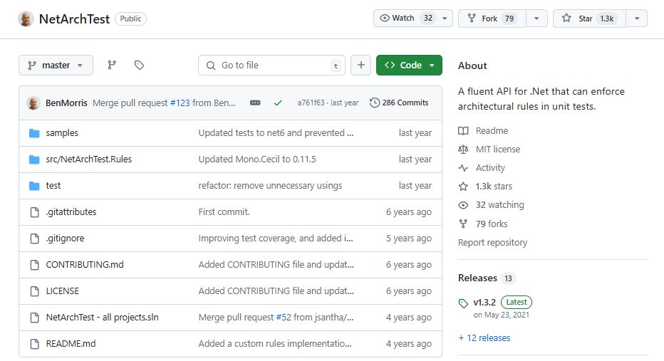
Introducing NetArchTest

Slide 9
NetArchTest
Created by Ben Morris.
Inspired by the ArchUnit library for Java.
A fluent API for .Net that can enforce architectural rules in unit tests.
Available on NuGet as “NetArchTest.Rules”

Slide 10

Writing Rules

Slide 11
Writing Rules
It’s very easy to create rules using the fluent API
First you load a set of types from a path, assembly or namespace.
Then you filter the types to a subset you wish to test against.
Finally, you apply a set of conditions to validate.

Slide 12
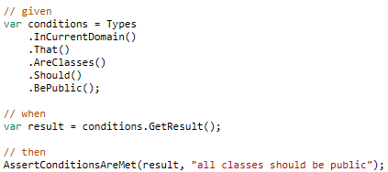
Writing Rules

Slide 13
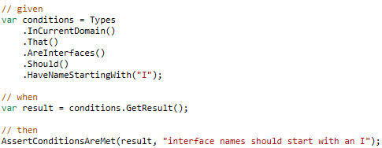
Writing Rules

Slide 14
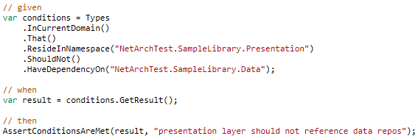
Writing Rules

Slide 15
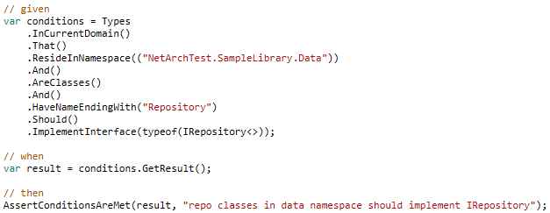
Writing Rules

Slide 16
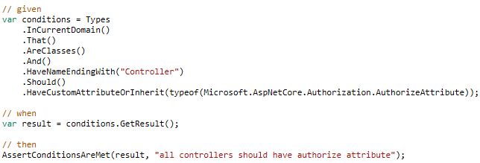
Writing Rules

Slide 17

Custom Rules

Slide 18
Custom Rules
You can create your own rules by writing custom rules.
Just create a class the implements the ICustomRule interface.

Slide 19
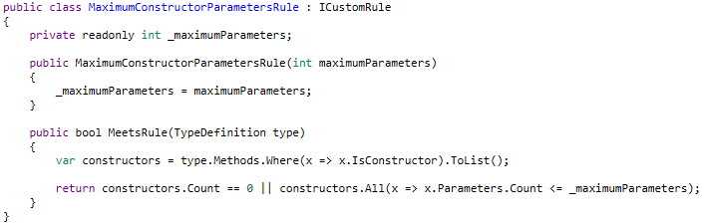
Custom Rules

Slide 20
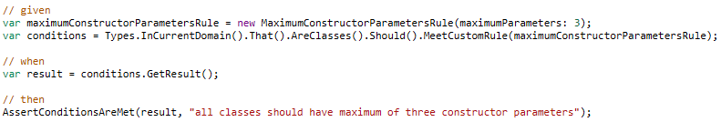
Custom Rules

Slide 21
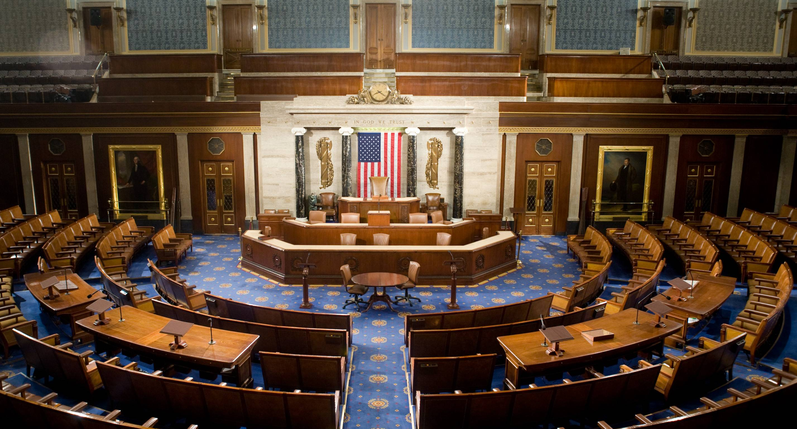
Policies

Slide 22
Policies
When you group multiple rules together you create a Policy.

Slide 23
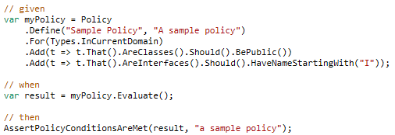
Policies

Slide 24

This is just a sample of what Architecture tests can do!
Go get started today!

Slide 25

Thank you!
Resources
https://github.com/BenMorris/NetArchTest
https://www.nuget.org/packages/NetArchTest.Rules
Similar Project
https://github.com/TNG/ArchUnitNET
Blog: alanbarber.com
Twitter: @alanbarber
GitHub: github.com/alanbarber
Alan P. Barber

