Slide 1

CQRS + MediatR An Introduction to CQRS with MediatR
Alan P. Barber
2022.05.26

Slide 2

Alan P. Barber
Principal Consultant at Improving
Software Developer
Computer Scientist
Scrum Master
Crohn's Disease Fighter
.NET Foundation Member
Husband & Father
Small-time Crypto Investor
Blog: alanbarber.com
Twitter: @alanbarber
GitHub: github.com/alanbarber

Slide 3

Disclaimer
I’m no expert.
I’m still learning.
I make no guarantees.

Slide 4
What are we here to talk about?
CQRS Pattern
An architecture pattern that helps organize our code.
Mediator Pattern
A behavioral pattern that defines how objects interact.
Domain Driven Design
A design methodology focused on building software to match the business domain.
MediaR Library
A simple mediator implementation in .NET.
Notes:
Objects are tightly coupled, if you make changes in any one of them you may affect code in other classes.
Tightly coupled objects are hard to implement, change, test, and reuse because they refer to and know about many different objects.

Slide 5
Domain Driven Design
A crash course in thinking differently…

Slide 6
What is a Domain Driven Design (DDD)?
“Domain-driven design (DDD) is a software design approach focusing on modelling software to match a domain according to input from that domain's experts.
In terms of object-oriented programming it means that the structure and language of software code (class names, class methods, class variables) should match the business domain. For example, if a software processes loan applications, it might have classes like LoanApplication and Customer, and methods such as AcceptOffer and Withdraw.”[1]
[1] https://en.wikipedia.org/wiki/Domain-driven_design
Notes:
DDD is a big topic and there are plenty of great books and online training to teach it in details.
The takeaway is that we should build sofrtware to match the business processes and use a common shared language between the business users and the code.

Slide 7
The CQRS Pattern
Command Query Responsibility Segregation (CQRS) – Big words for such a small idea!

Slide 8
What is a CQRS?
“…is a principle of imperative computer programming.
It states that every method should either be a command that performs an action, or a query that returns data to the caller, but not both. In other words, asking a question should not change the answer.” [1]
[1] https://en.wikipedia.org/wiki/Command-query_separation

Slide 9
What every app truly does…
C
Create
R
Read
U
Update
D
Delete
Notes:
Objects are tightly coupled, if you make changes in any one of them you may affect code in other classes.
Tightly coupled objects are hard to implement, change, test, and reuse because they refer to and know about many different objects.

Slide 10
One of these is not like the others…
Commands
Queries
Create
Read
Update
Delete

Slide 11
Focus on the actions, not objects
No more building monolithic objects and services
Create small modular code blocks to process commands and queries

Slide 12
Benefits of splitting it up…
Simplicity
Reliability
Security
Scalability / Performance

Slide 13
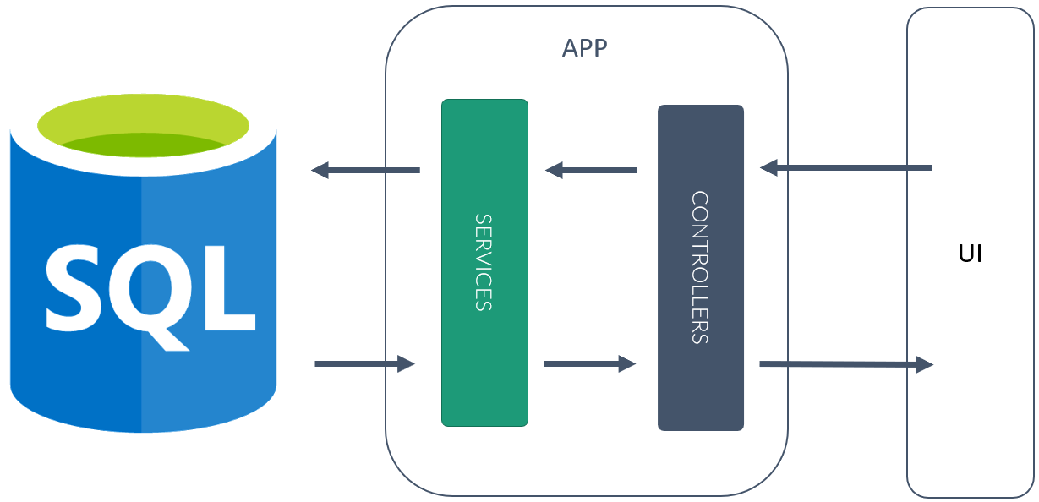
Standard n-tier application

Slide 14
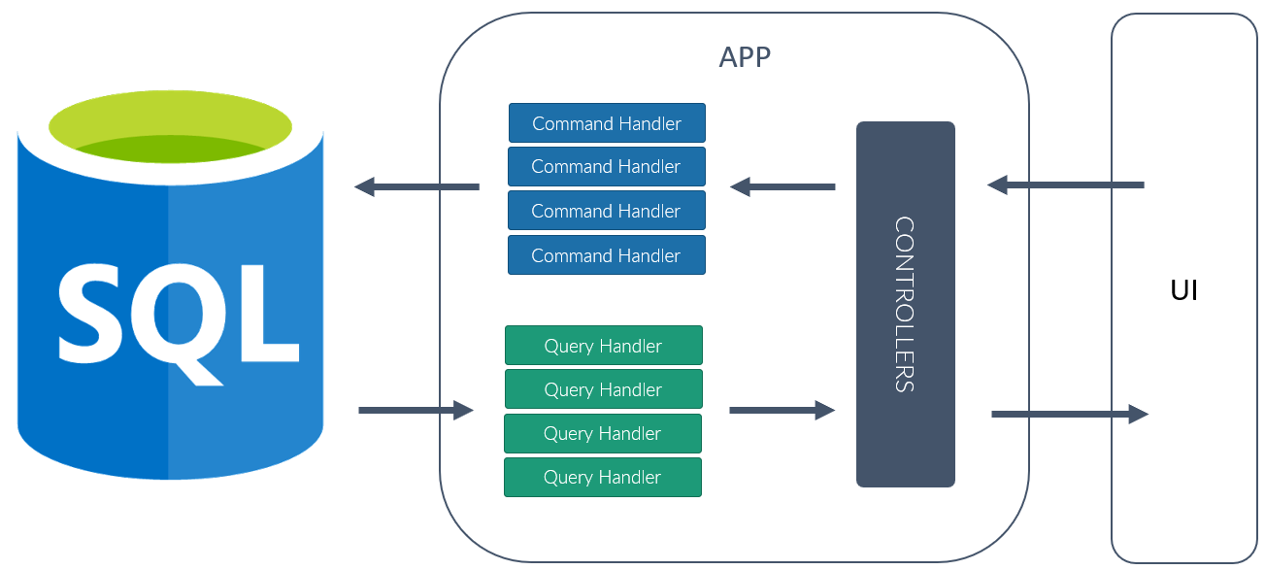
CQRS + MediatR application

Slide 15
The Mediator Pattern
I think it’s time we break up… Sorry I meant the code, not us! I still love you!

Slide 16
What is the Mediator pattern?
“With the mediator pattern, communication between objects is encapsulated within a mediator object. Objects no longer communicate directly with each other, but instead communicate through the mediator. This reduces the dependencies between communicating objects, thereby reducing coupling.” [1]
[1] https://en.wikipedia.org/wiki/Mediator_pattern

Slide 17
The normal way – tight coupling
Object A
Object B
Object C
Object D
Notes:
Objects are tightly coupled, if you make changes in any one of them you may affect code in other classes.
Tightly coupled objects are hard to implement, change, test, and reuse because they refer to and know about many different objects.

Slide 18
The Mediator way – loose coupling
Object A
Object B
Mediator
Object C
Object D

Slide 19
The MediatR Library
There’s a library for everything!

Slide 20

MediatR
Simple mediator implementation in .NET
In-process messaging with no dependencies.
Supports request/response, commands, queries, notifications and events, synchronous and async with intelligent dispatching via C# generics.
Works well with and has support for Microsoft DI, StructureMap, AutoFac, Ninject, Castle Windsor, and more!
https://github.com/jbogard/MediatR

Slide 21
The fundamentals
Message
An object used to make a request to the mediator.
Handler
An object that processes the request for the mediator.

Slide 22
Message / Request
public class Ping : IRequest<string> { }

Slide 23
Handler
public class PingHandler : IRequestHandler<Ping, string>
{
public Task<string> Handle(Ping request, CancellationToken cancellationToken)
{
return Task.FromResult("Pong");
}
}

Slide 24
Sending the message to the mediator
var response = await mediator.Send(new Ping());
Debug.WriteLine(response); // "Pong"

Slide 25
Demo – Let’s get coding!
Implementing CQRS with MediatR in a perfect world…

Slide 26

Questions or Comments

Slide 27

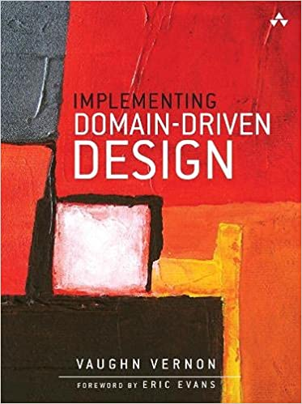
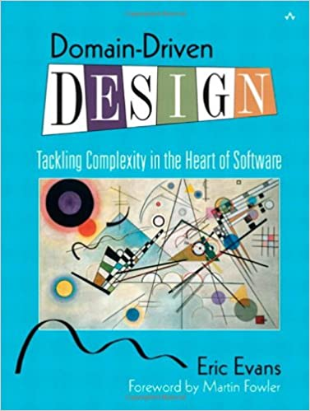
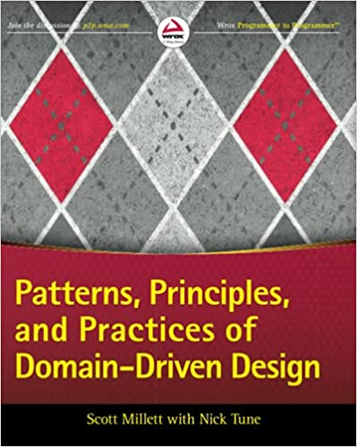
Thank you!
Blog: alanbarber.com
Twitter: @alanbarber
GitHub: github.com/alanbarber
Resources
https://github.com/jbogard/MediatR
https://docs.microsoft.com/en-us/azure/architecture/patterns/cqrs

