Slide 1
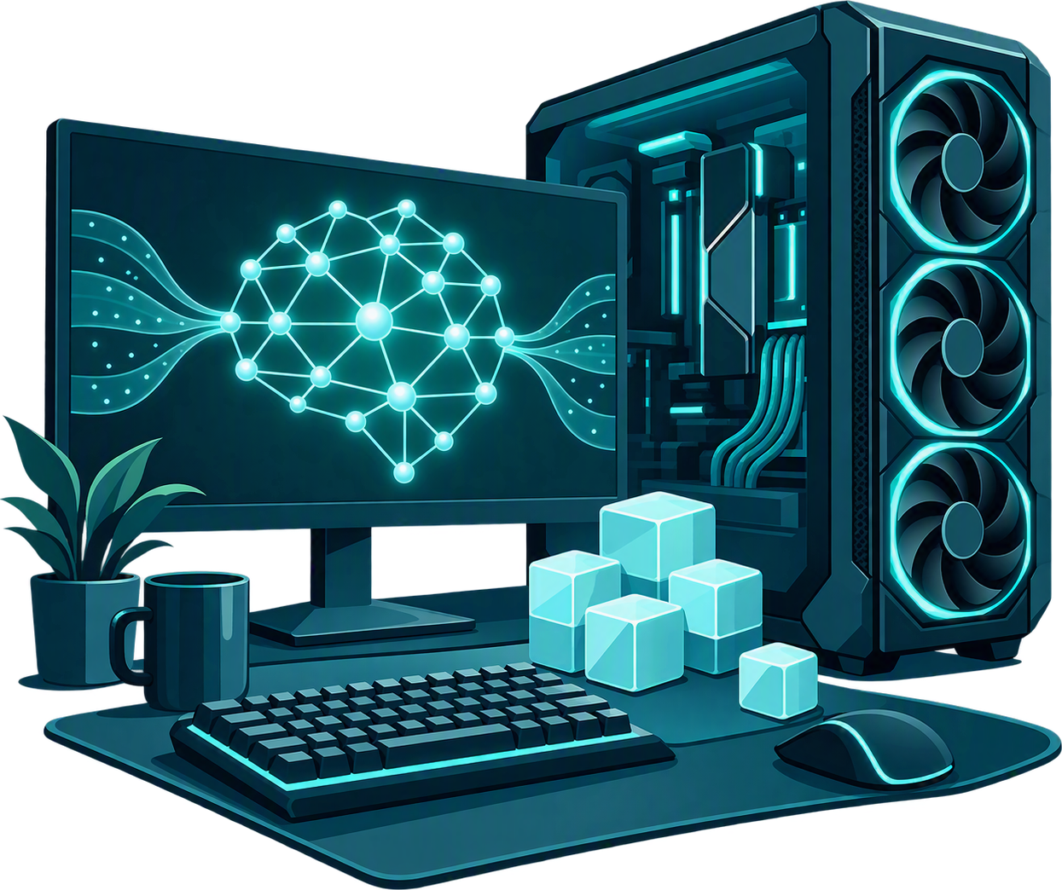

Tensors, Tokens
&
Too Much VRAM
A Developer's Guide to Running LLMs Locally
Alan P. Barber
Principal Consultant, Improving
Blog: alanbarber.com
Twitter: @alanbarber
GitHub: github.com/alanbarber
Made with real AI! Warning: May contain traces of human intelligence.
Notes:
Tensors, Tokens & Too Much VRAM: A Developer's Guide to Running LLMs Locally
What actually happens when you send a prompt to an LLM? What are tokens, tensors, attention, quantization, and all those mysterious gigabytes of VRAM doing? And why does your GPU suddenly become the most important piece of hardware in the room?
This talk takes a developer-friendly tour through the fundamentals of modern LLMs. We’ll try to demystify concepts like context windows, model quantization, and inference performance without requiring a PhD in linear algebra.
Then we'll take those concepts out of the textbook and into the real world, looking at tools such as Ollama, LM Studio, and vLLM and what it takes to run useful models on your own hardware.
By the end, you'll have a mental model for what an LLM is actually doing, how local inference works, and why sometimes the answer to "How much VRAM do I need?" is apparently "all of it."

Slide 2
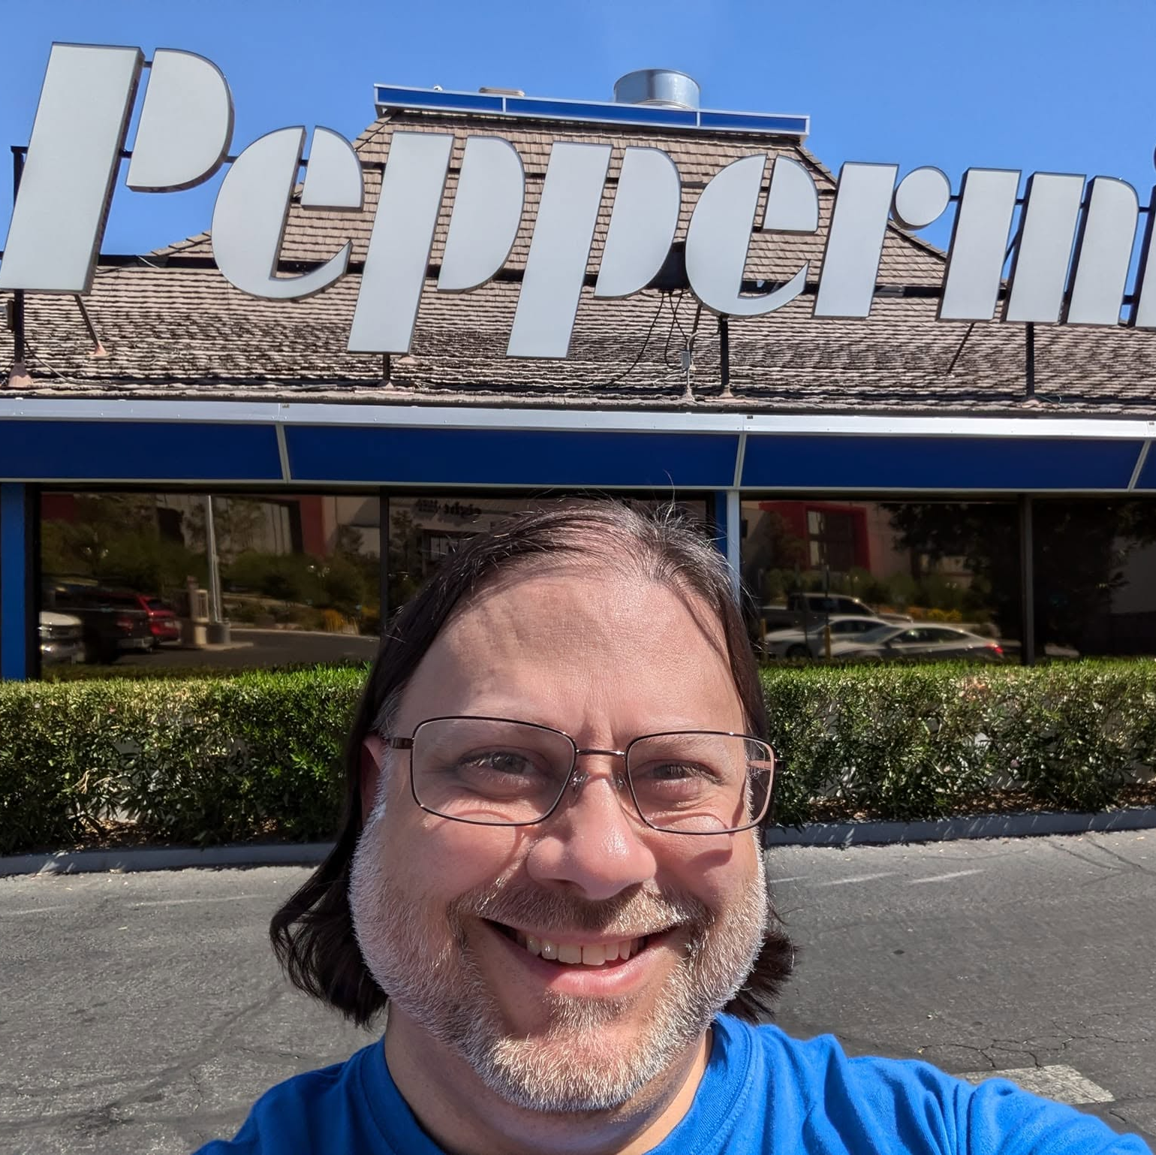
Alan P. Barber
Principal Consultant at Improving
Software Developer
Computer Scientist
Scrum Master
Crohn's Disease Fighter
.NET Foundation Member
Husband & Father
Local AI Hobbyist
I make computers do things. Sometimes intentionally.

Slide 3

Disclaimer
I’m no expert.
I’m still learning.
I make no guarantees.
Don’t blame me when your GPU catches fire!

Slide 4
Our Goals
How LLMs Work
Get a high-level understanding of how LLMs process tokens, learn relationships, and generate responses, including the key concepts behind their seemingly intelligent behavior.
Running LLMs Locally
Explore the software, models, and hardware that make local AI possible, understand the trade-offs, and discover what it takes to run LLMs on your own machine.
Let’s part the “clouds” and get a closer look!

Slide 5
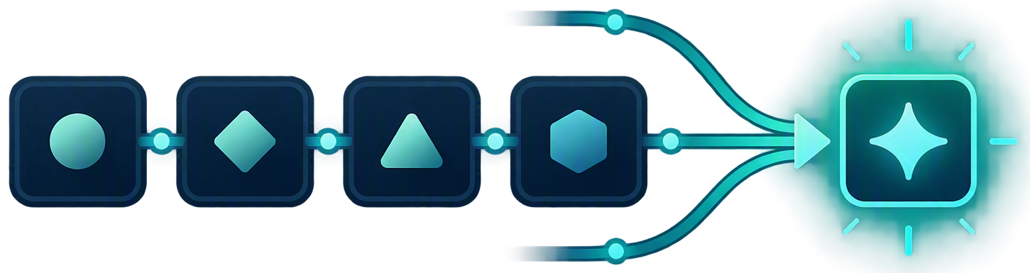
What Actually Is an LLM?
At a very high level, an LLM is just a giant statistical database of linked tokens (words or pieces of words) that an engine uses to predict the most likely next token, over and over, based on patterns learned from massive amounts of training text.
It’s autocomplete, if it ate the entire internet.

Slide 6
From Prompt to Prediction
PROMPT → TOKENS
VECTOR SPACE
01
02
03
04
05
Your prompt
Tokenizer
Token IDs
Embeddings
Tensors
10
09
08
07
06
Repeat
Next token
Probabilities
Logits
Transformer
PREDICTION LOOP
Turns out "guess the next word" scales surprisingly well.

Slide 7
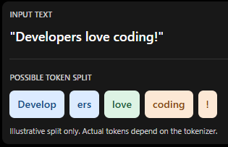
Tokens: The Language of LLMs
A chunk of text: a word, part of a word, punctuation, or even whitespace.
A tokenizer breaks text into tokens and maps them to numerical IDs.
Different models can split the same text differently.
Words are so last generation.
Notes:
Think of tokens as the pieces of language the model actually works with. Sometimes that's a whole word, sometimes it's just a few characters. Before an LLM can do anything with our text, it has to break it down into these pieces and turn them into numbers.

Slide 8
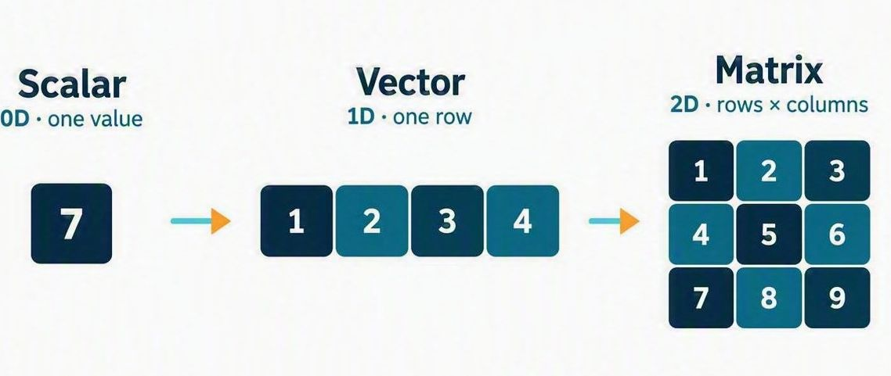
Tensors: Just Complex Arrays
Think of a tensor as a fancy way of organizing numbers, from a simple list to massive multidimensional arrays. LLMs use these giant collections of numbers to move information through the model and perform all those calculations that make the magic happen.
I’m so tense I need a massage…
Notes:
Don't let the word tensor scare you. At its core, it's just an array of numbers. The interesting part is how many of them we're dealing with and how they're arranged. An LLM pushes these massive collections of numbers through layer after layer of mathematical operations to produce its next token.

Slide 9
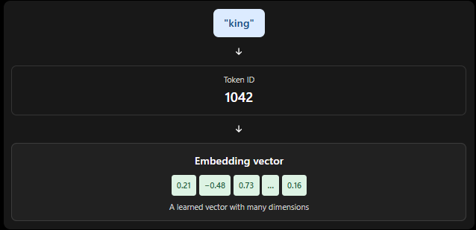
Embeddings: Turning Tokens Into Numbers
Embeddings are a vector of numbers that represent a given token
They are calculated during training
Tokens that are of a similar context / meaning will share similar vectors
Why did the token get an embedding? It wanted more dimension in its life.
Notes:
A token ID tells the model which token it's looking at. An embedding gives it a whole vector of learned numbers to work with. It's a little like replacing a word with a numerical fingerprint, except that fingerprint can capture useful patterns and relationships rather than just identify the word

Slide 10
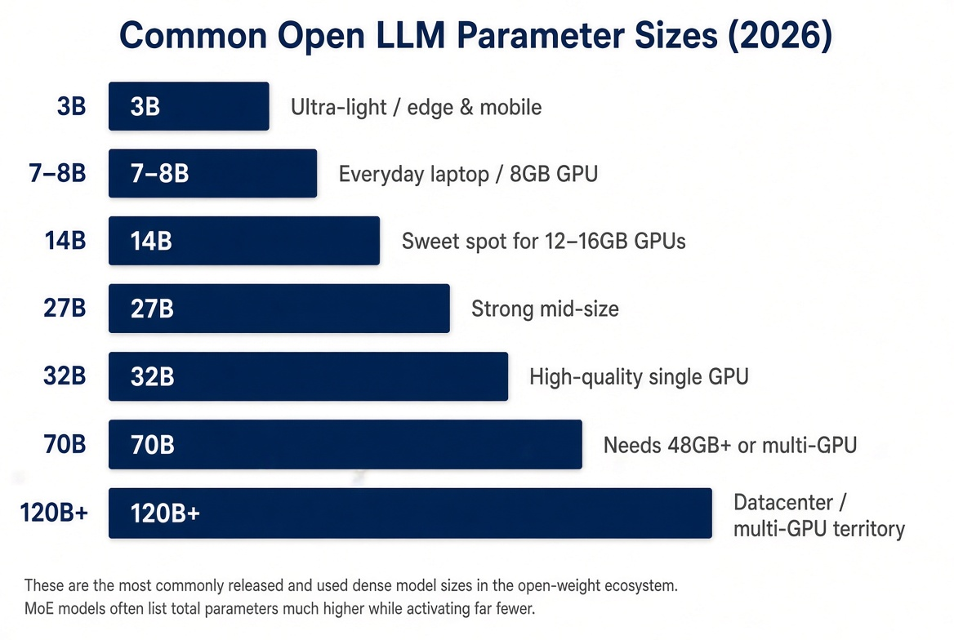
Parameters: The Models Learned Knowledge
Parameters are the tiny numbers inside the model that store everything it has learned.
The more parameters a model has, the more knowledge and ability it can hold - but the more memory and power it needs to run.
It’s not the size of your parameters, it’s how you use them.
Notes:
Parameters are the adjustable numbers the model learned during training. Think of them as the model's learned configuration. More numbers can mean more capacity, but just like with developers, headcount alone doesn't tell you how good the work will be

Slide 11
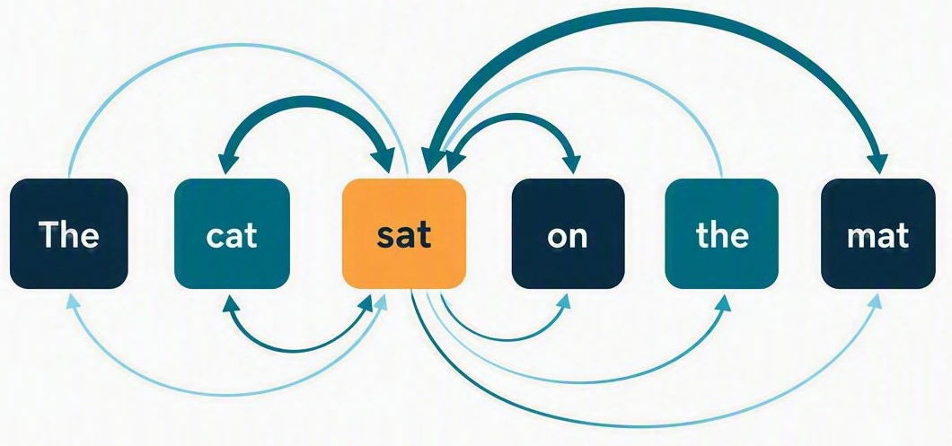
Attention: Linking Tokens Together
Every token looks at every other token in the sequence and decides how much attention to pay to it.
This lets the model figure out which tokens are most relevant to each other, no matter how far apart they are.
Attention: the AI equivalent of ‘Who were you talking to?’

Slide 12
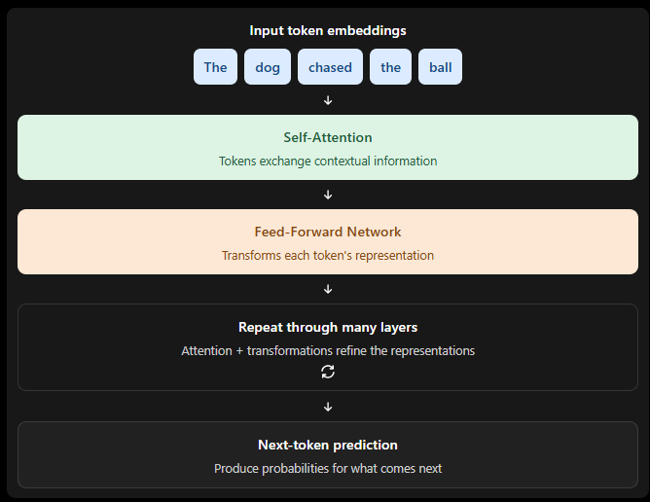
Transformers: Where Intelligence Begins
Transformers are the architecture behind modern LLMs, allowing tokens to share information through a mechanism called attention.
They process and refine those representations through multiple layers, helping the model understand context and predict what comes next.
Modern LLM models can have dozens or even hundred+ layers of transformers
Transformers: Intelligence in disguise.
Notes:
Embeddings give us the numbers, but they don't tell the whole story. Transformers let tokens exchange information through attention, then process that information through layer after layer. That's where the model starts building the contextual patterns .

Slide 13
Putting The Pieces Together
Example prompt:
“Write me a c# function to add two number”
Result:
Public -> static –> int Add -> …
What it’s doing…
Tokenize the prompt
Embed the tokens
Run the transformer
Predict the next token
It’s just math… until it starts analyzing your dreams!

Slide 14
AI is a Moving Target
Everything we’ve covered represents how modern LLMs work today, but the science of AI is constantly evolving.
Researchers are developing new algorithms, architectures, and techniques to make models smarter, faster, more efficient, and more useful.
What seems cutting-edge today may be yesterday’s news tomorrow. The fundamentals give us a foundation, but the possibilities are still being explored.
Everything I just said is probably considered outdated…Sorry!

Slide 15
Why Would You Run AI Locally?
Privacy
No API costs
Offline access
Experimentation
Finally, a legitimate excuse to tell your spouse that the new graphics card is for "work."

Slide 16
The Local AI Ecosystem
Applications
User interfaces & tools
Engines
Software that runs the models
Models
The actual AI brain
Hardware
The computing muscle
It's simple: pick a model, pick an engine, pick a UI, pick a framework...

Slide 17
The Local AI Ecosystem - Applications
Visual Studio Code
OpenClaw
Open WebUI
LM Studio
A hundred other apps!
How we put the magic monkeys to work

Slide 18
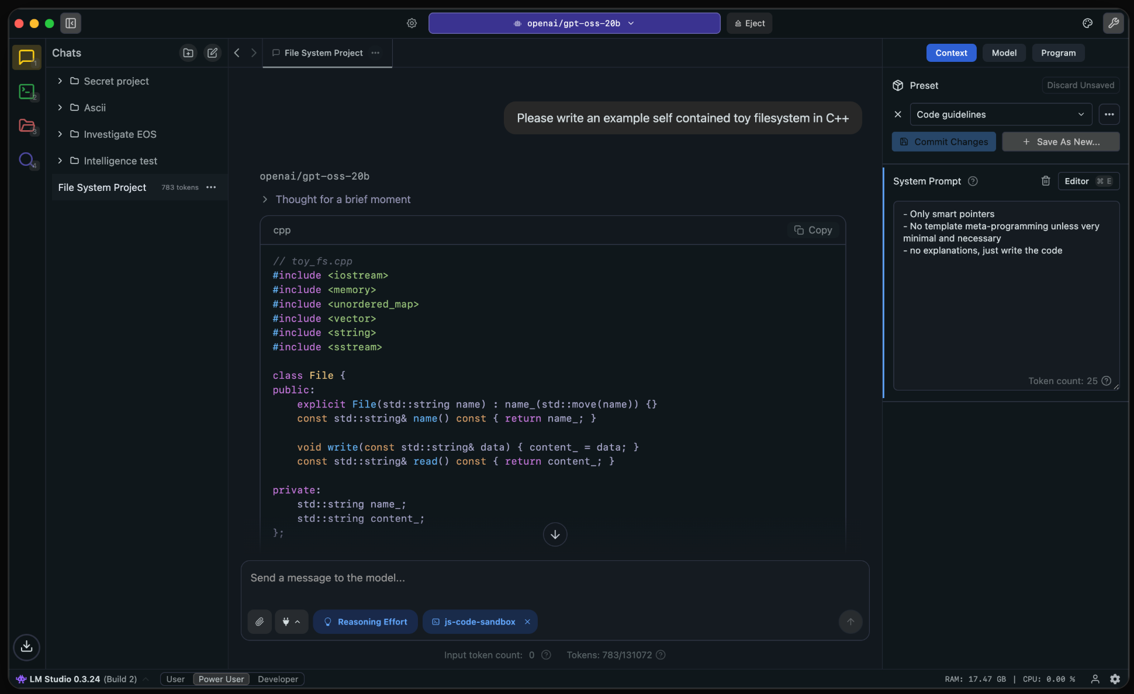
LM Studio
LM Studio is a graphical frontend for running local LLMs, providing model management, chat, and an OpenAI-compatible API powered by llama.cpp.
Runs on Windows, Macs and Linux!
It's so easy a caveman can use it!

Slide 19
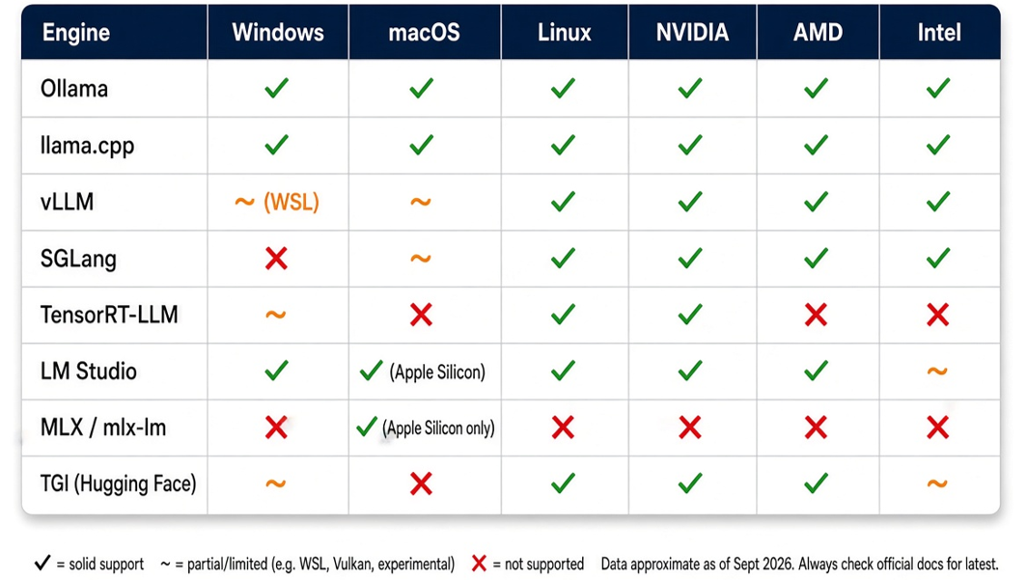
The Local AI Ecosystem - Engines
Because one way to run AI would have been too easy

Slide 20
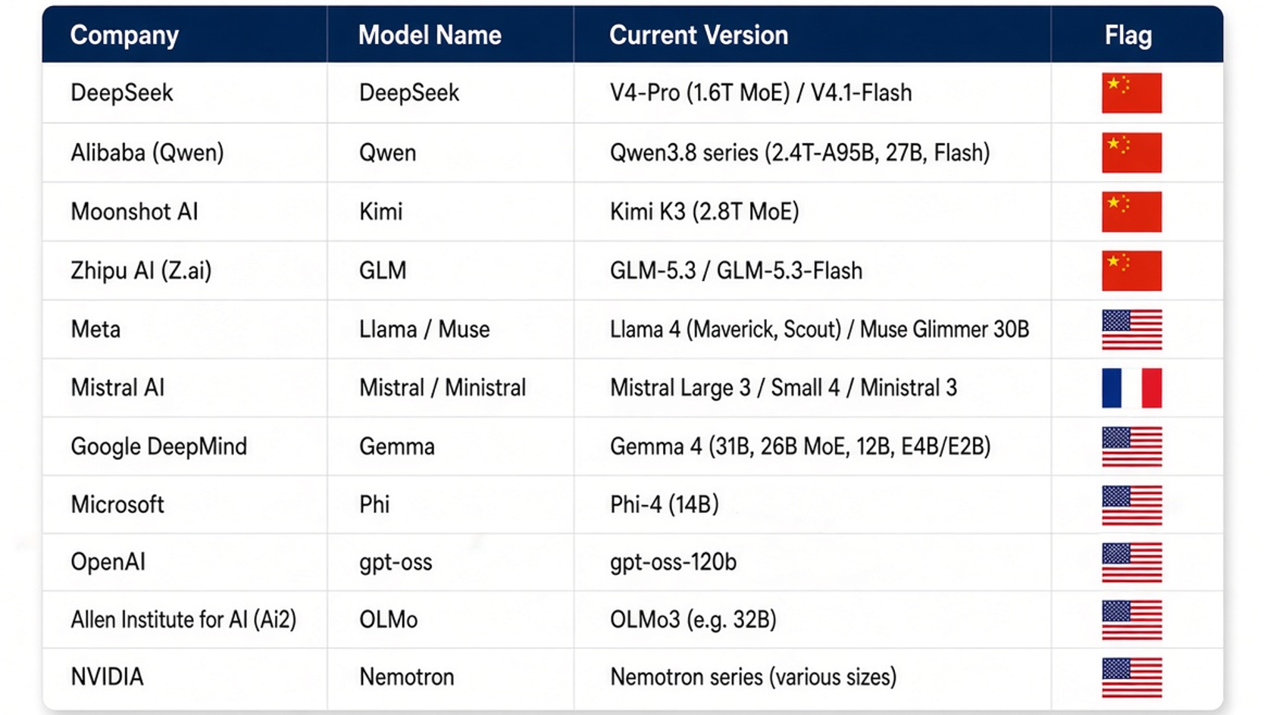
The Local AI Ecosystem - Models
Like Pokémon, but instead of collecting creatures you collect 70GB files

Slide 21
Choosing a Model
There is no single "best" model
Selecting an LLM is a balancing act. The best choice depends on what the model is designed to do and the hardware available to process it.
Bigger isn't always better... but it sure is fun to make your computer cry!

Slide 22
Choosing a Model – The Trade Offs
Model size & capability
More parameters can offer greater capacity, but size alone doesn't guarantee better results.
Memory & quantization
Lower-precision weights reduce memory use, often with some trade-off in quality.
Speed & hardware
Your GPU, available VRAM, memory bandwidth, and model architecture all affect performance.
Context window
A larger context can handle more input, but using it consumes additional memory and compute.
The AI version of "good, fast, cheap — choose two"
Notes:
Model selection is a balancing act. You want enough capability to do the job, enough context to handle your input, and enough speed that you're not waiting until next Tuesday for an answer. The trick is finding the model that fits your workload and your hardware.

Slide 23
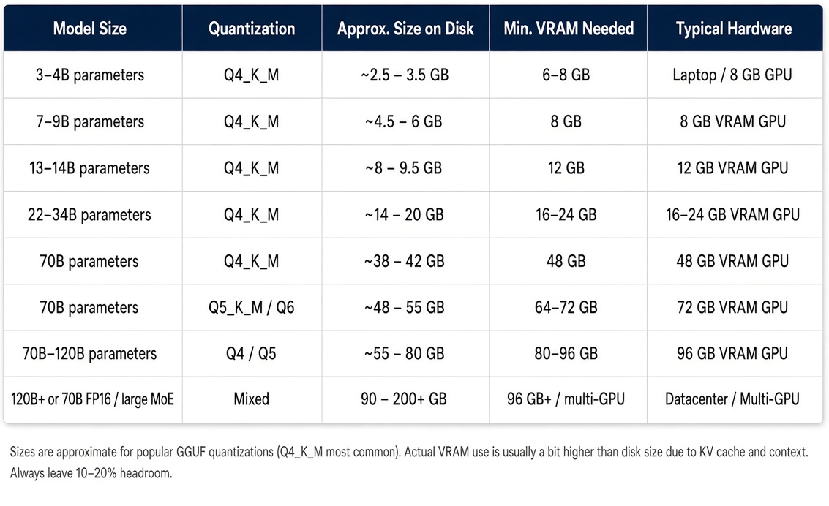
Choosing a Model – A Sampling of Sizes
Welcome to the “I wish I had more VRAM" support group!

Slide 24
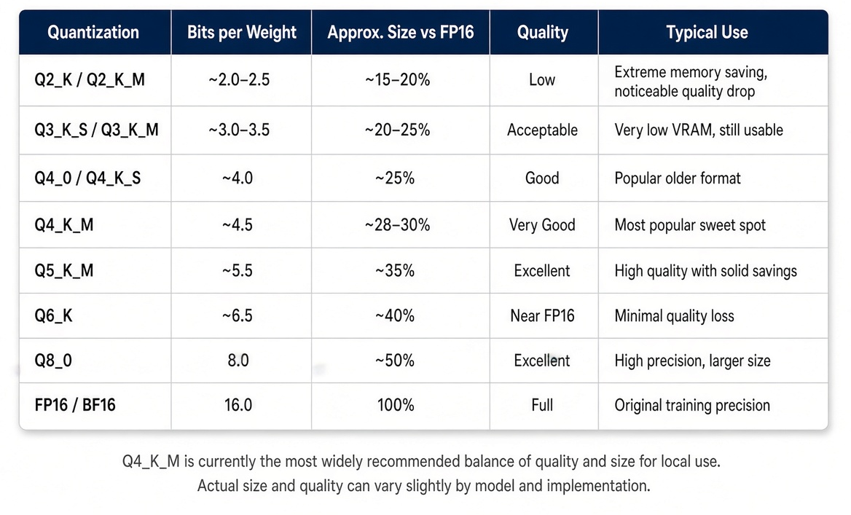
Choosing a Model – Quantization (Compression)
Representing model weights using fewer bits.
Reduces the memory required to store and run a model.
Can improve performance, depending on the hardware and inference software.
Lower precision can introduce some loss of model quality.
Q4: because even AI has to watch its weight
Notes:
Quantization is basically putting your model on a diet. We use fewer bits to store its weights, which saves memory. The trick is losing a little numerical precision without losing too much of what makes the model useful.

Slide 25
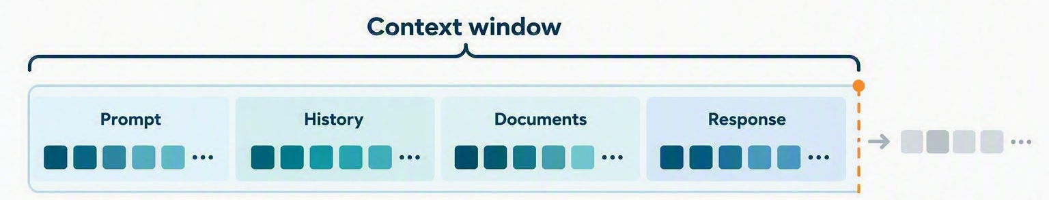
Choosing a Model – Context (Working Memory)
The maximum amount of tokenized information the model can handle in a single sequence.
Includes the prompt, conversation history, supplied documents, and generated response.
Measured in tokens, not words or pages.
Infinite context wouldn’t make it smarter. It would just give it more things to be confidently wrong about.
Notes:
Context is the model's working space. If you're asking it to review a large codebase, the context window determines how much of that information can fit into the conversation at once. And remember, the answer it generates takes up space too.

Slide 26
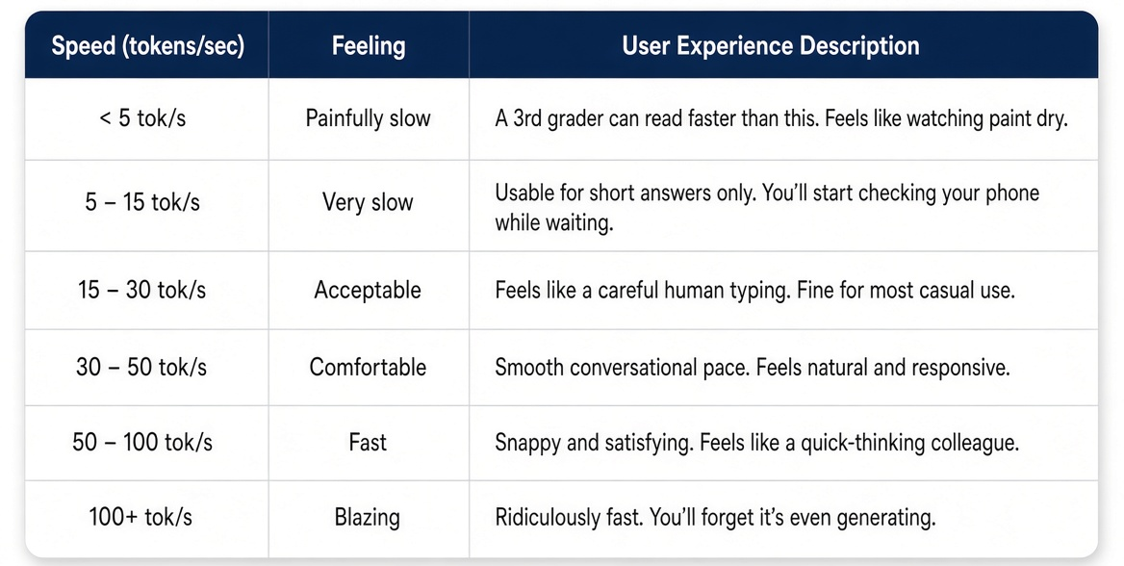
The Speed Limit - Tokens per Second (tok/s)
The difference between "it works" and "I actually want to use this"

Slide 27
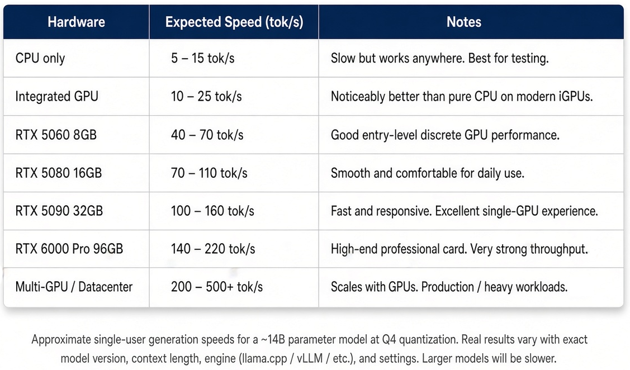
The Speed Limit – Tokens per Second (tok/s)
You will have that moment where you debate selling a kidney for a faster GPU!

Slide 28
Demo Time!
Every live demo begins with confidence and ends with "Well... it worked this morning."

Slide 29
Go Forth and Tokenize
Local AI is accessible on almost any modern computer—no data center required.
Local models won't replace frontier models like Opus or GPT-5, but many are remarkably capable for everyday coding, writing, and problem-solving.
The local AI ecosystem is evolving rapidly—expect to experiment, tweak settings, and occasionally troubleshoot along the way.
Today: "I ran a model locally." Tomorrow: "I need to buy a server rack!"

Slide 30

Thank You / Q&A
Alan P. Barber
Principal Consultant, Improving
Blog: alanbarber.com
Twitter: @alanbarber
GitHub: github.com/alanbarber

